Slide 1
VHDL Very High Speed Integrated Circuits Hardware Description Language
The vast majority of this powerpoint comes from the VHDL tutorial
in the Georgia Tech lab book by Furman (the VHDL tutorial posted
on ASU learn), and the “FPGA Prototyping by VHDL Examples” and “RTL
Hardware Design Using VHDL” books by Chu. There is also some material
from the Digital Systems book by Tocci. The site www.NandLand.com
has tutorials on FPGAs and VHDL. Help on VHDL commands is on the
websites: http://vhdl.renerta.com/ and
https://www.ics.uci.edu/~jmoorkan/vhdlref/

Slide 2
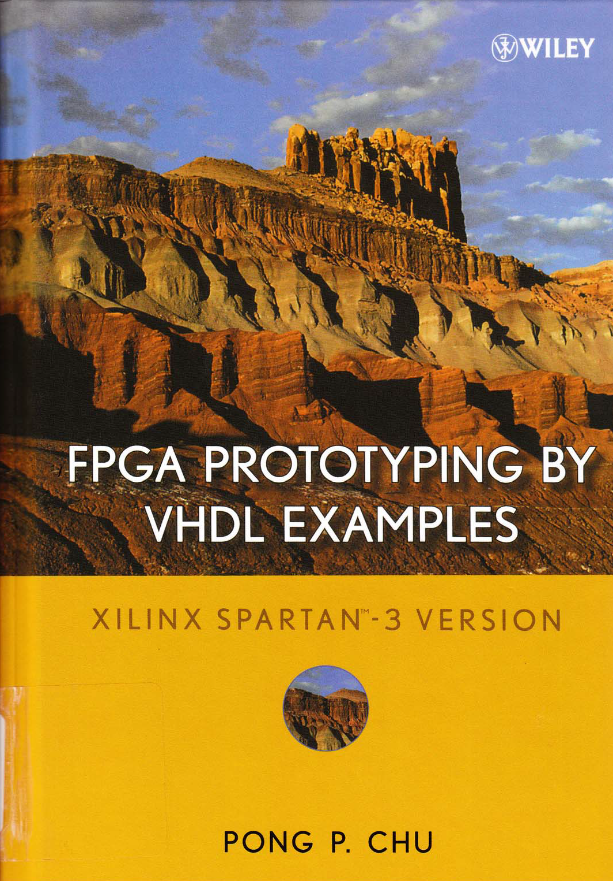
This text was written for Xilinx
(the main competitor of Altera),
but most VHDL commands work on both FPGAs.

Slide 3


















































Simulation only

Slide 5
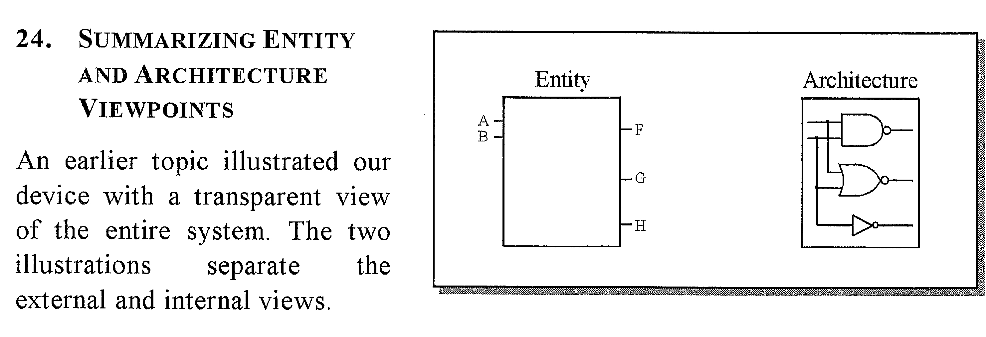

Slide 6
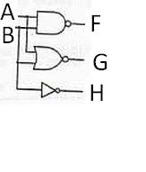
ARCHITECTURE arch OF basis_gates IS
BEGIN
F <= A nand B;
G <= A nor B;
H <= not B;
END arch;
The 3 circuits run concurrently (simultaneously) in parallel. However, usually output H changes first because an INVERTER is a faster gate than a NAND or a NOR.

Slide 7
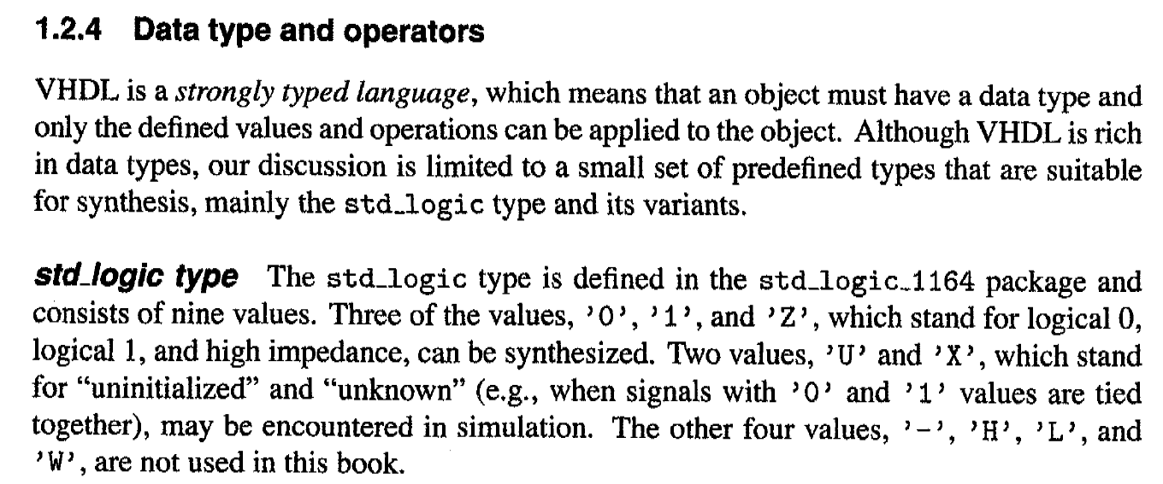
















Slide 8
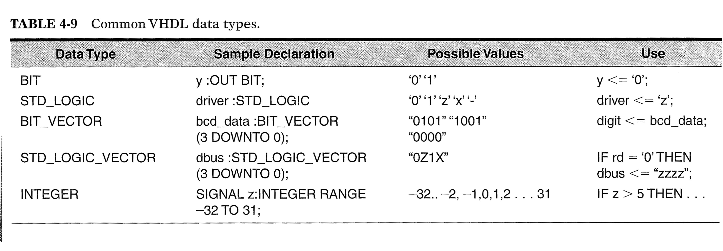











Slide 9
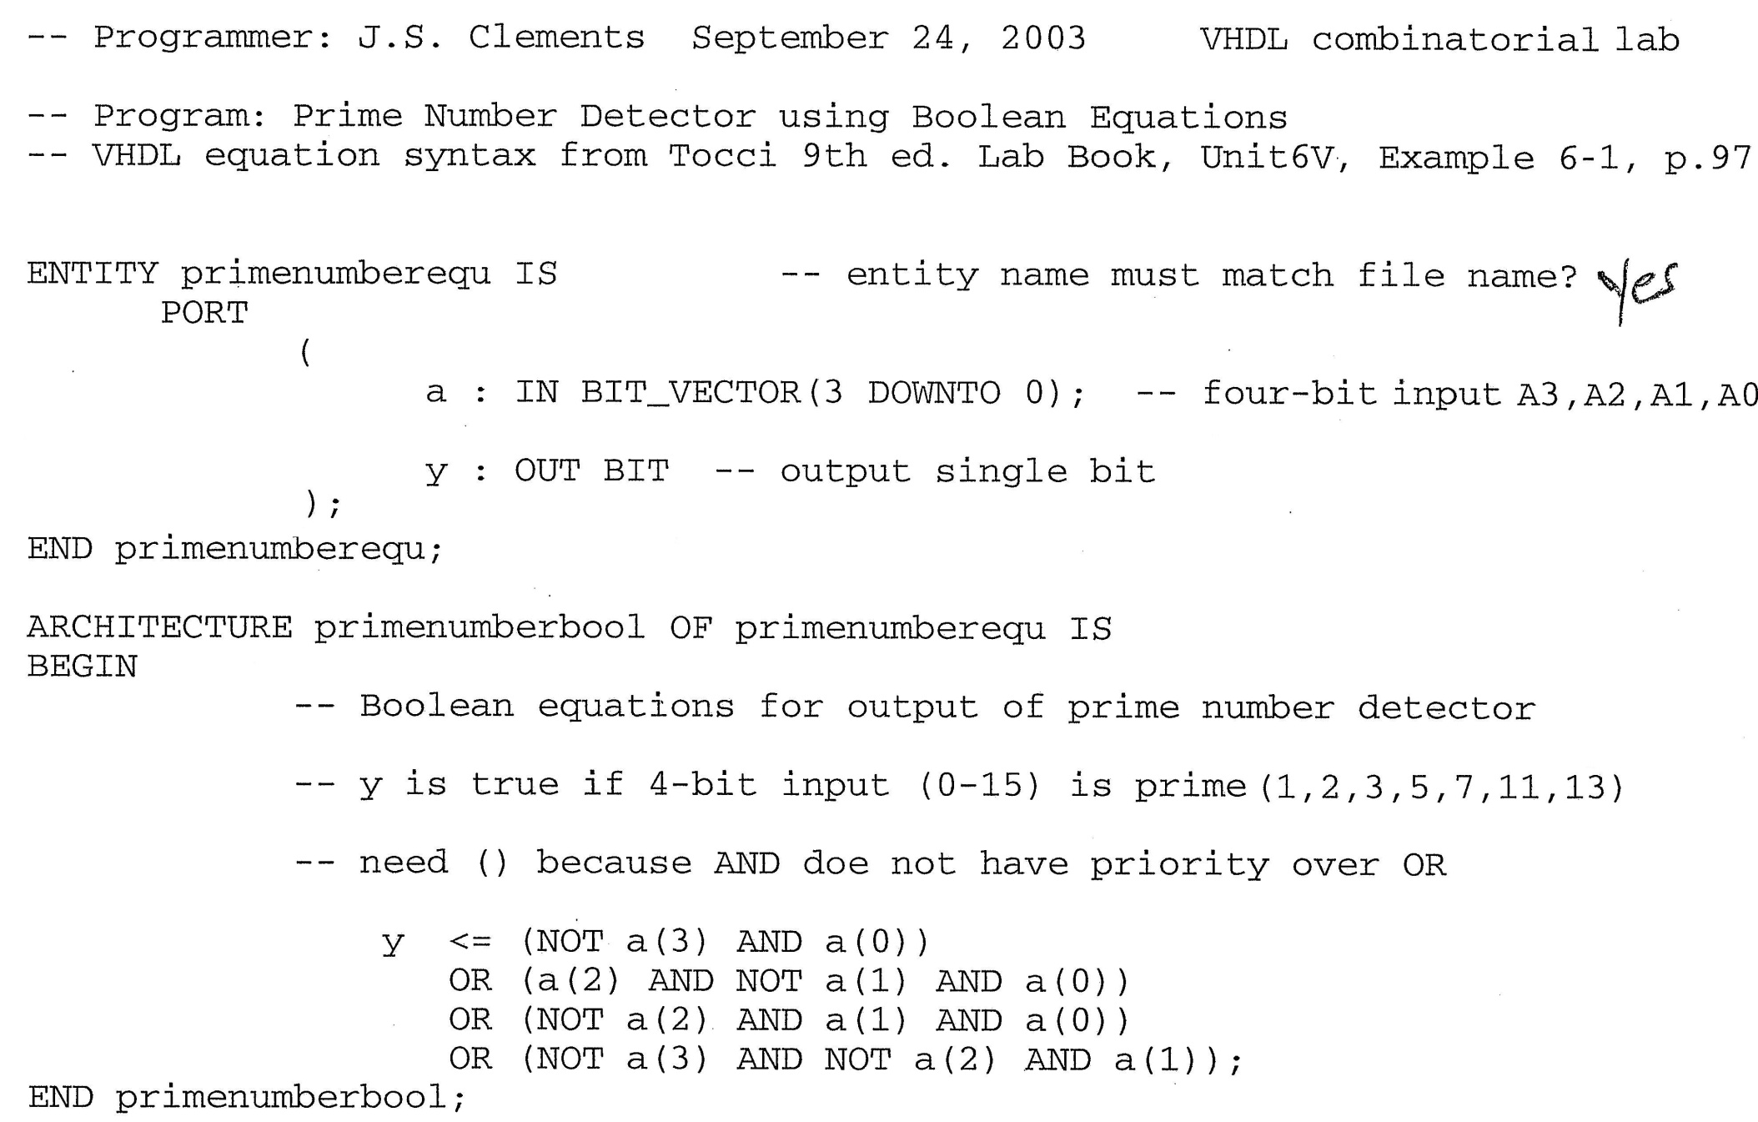

Boolean equation – but don’t use bit vector, use std_logic_vector.

Slide 10



Tocci – but don’t use bit vector, use std_logic_vector because the Altera
library uses it and so does the rest of the world.
What circuit does this VHDL make?

Slide 11
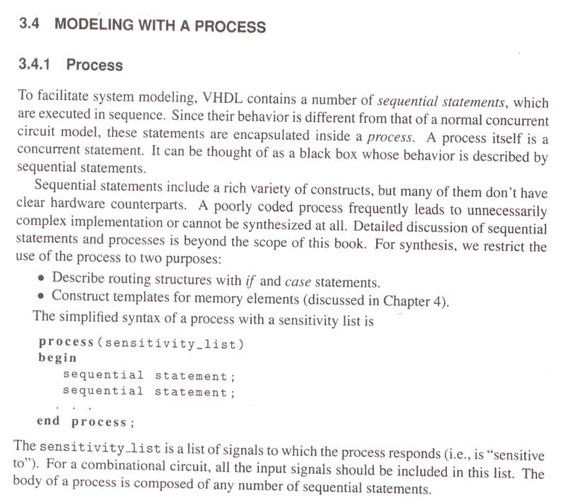








Slide 12
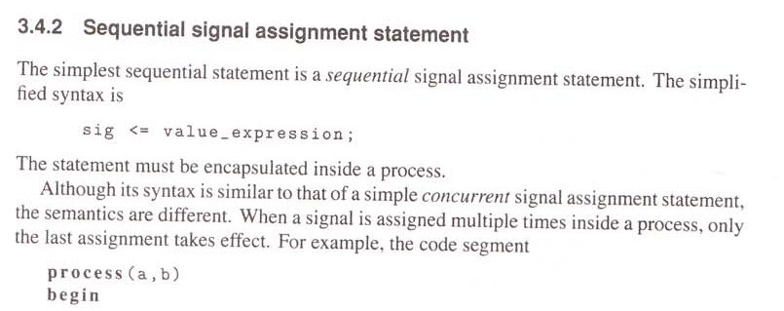


Slide 13
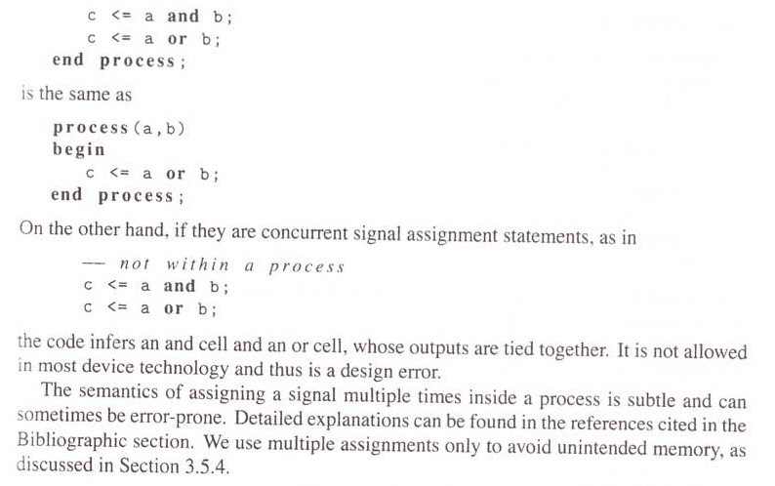







Slide 14
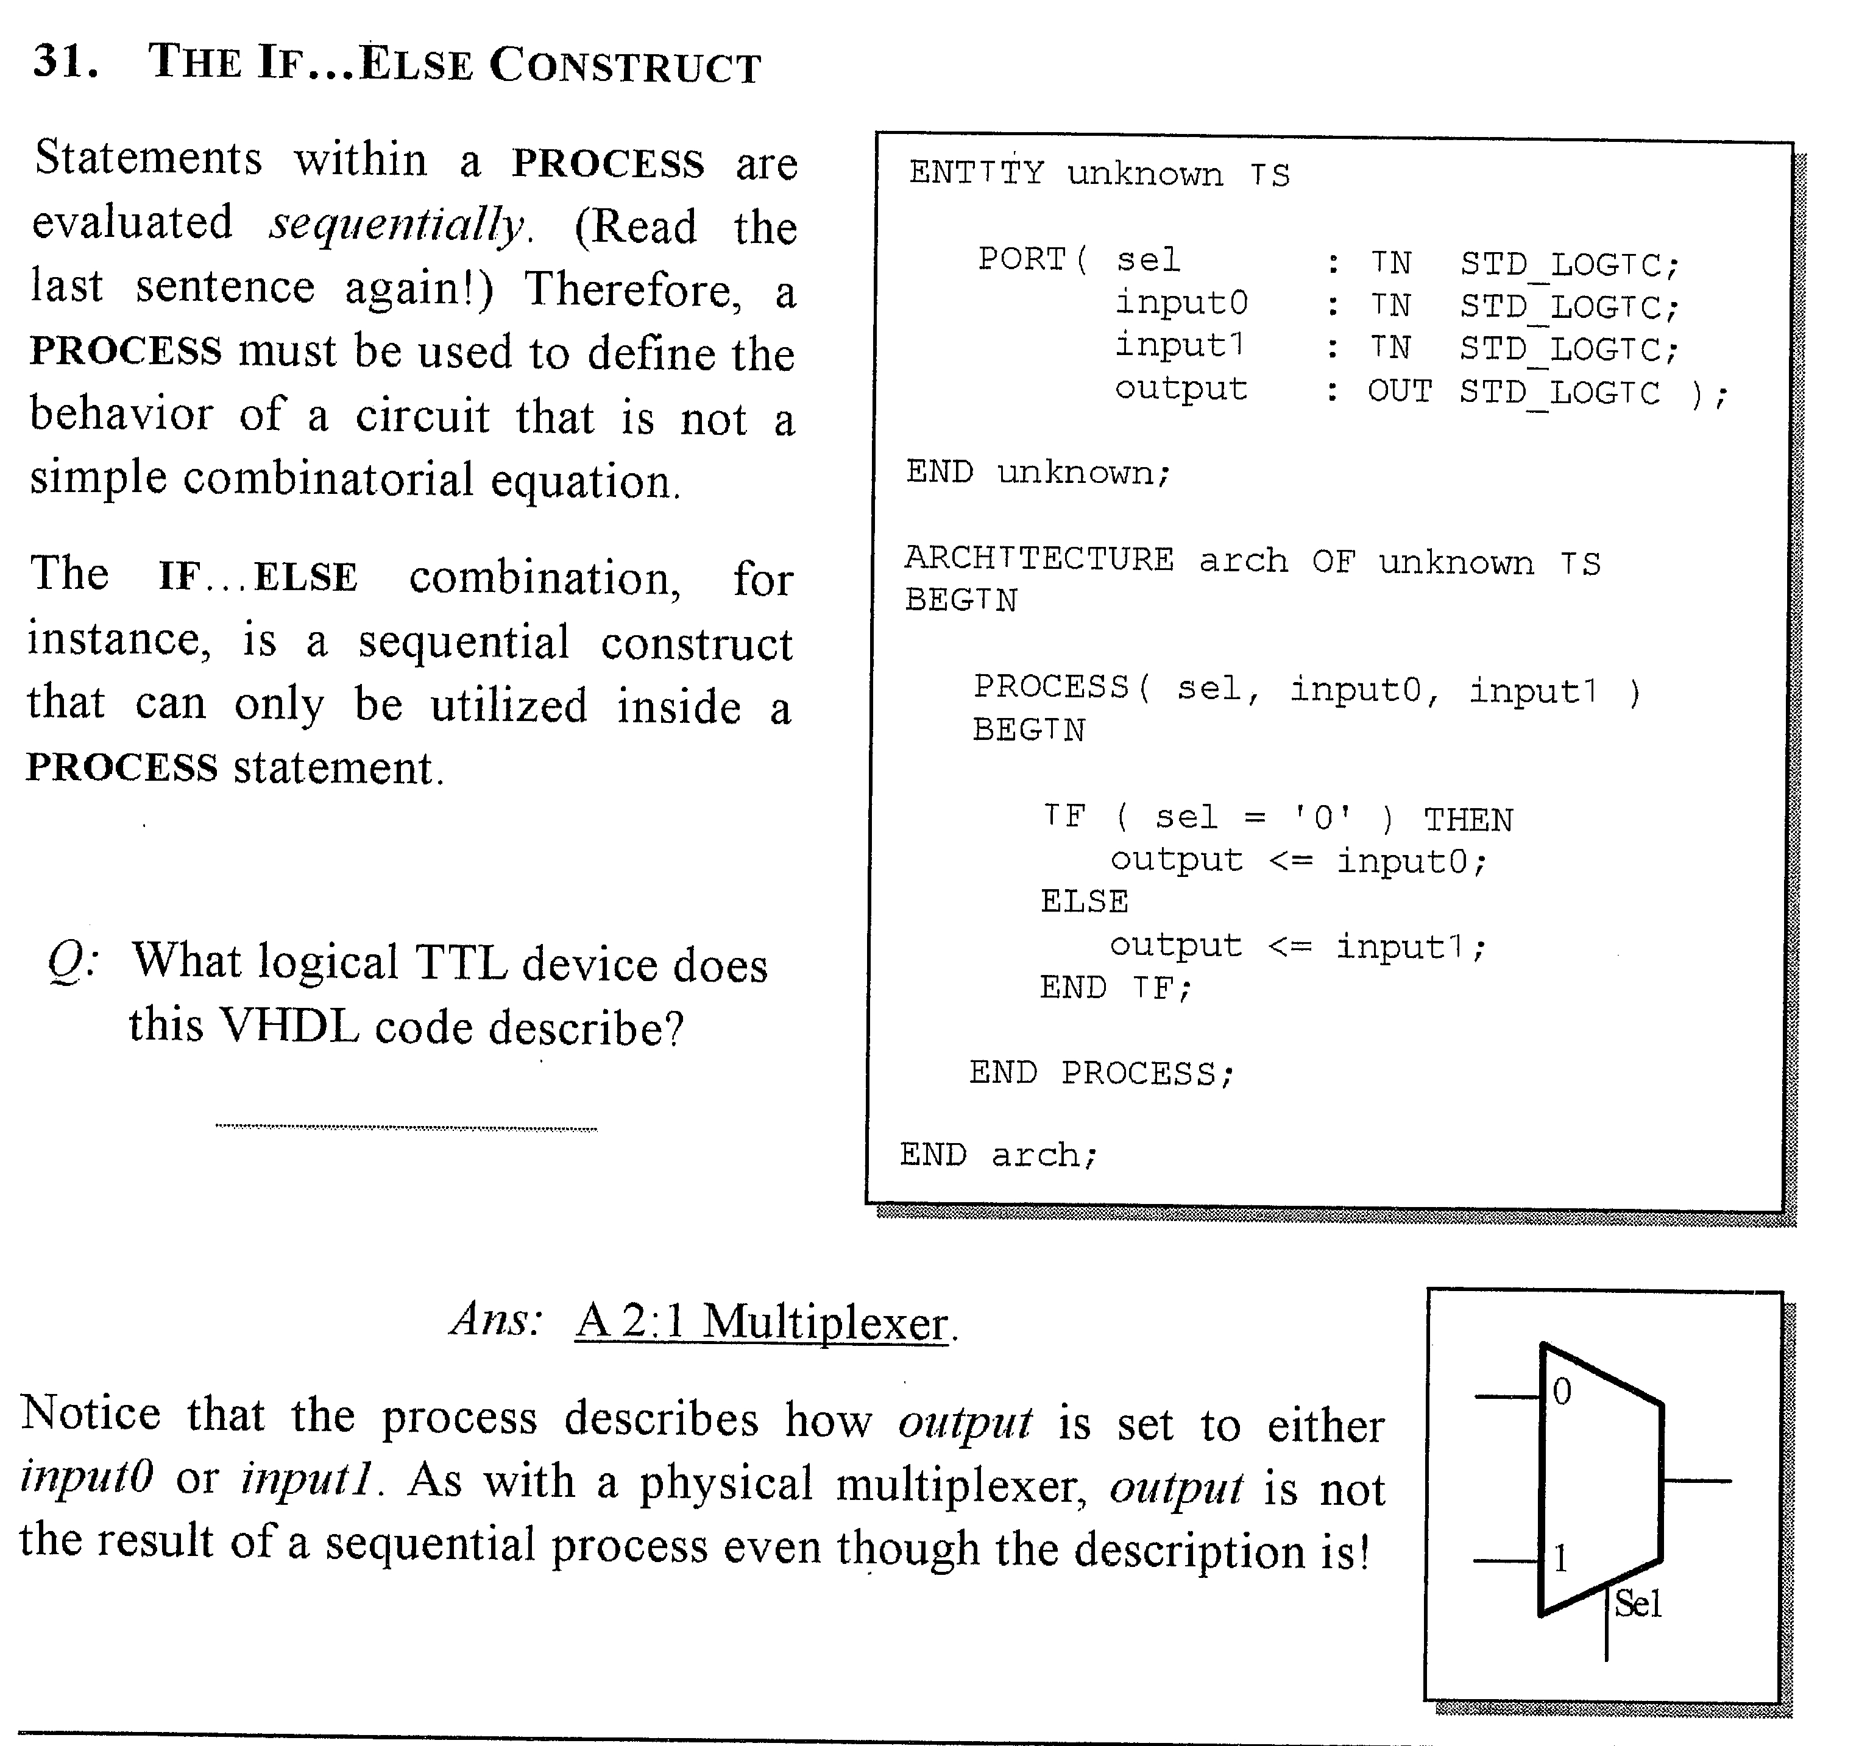

Slide 15
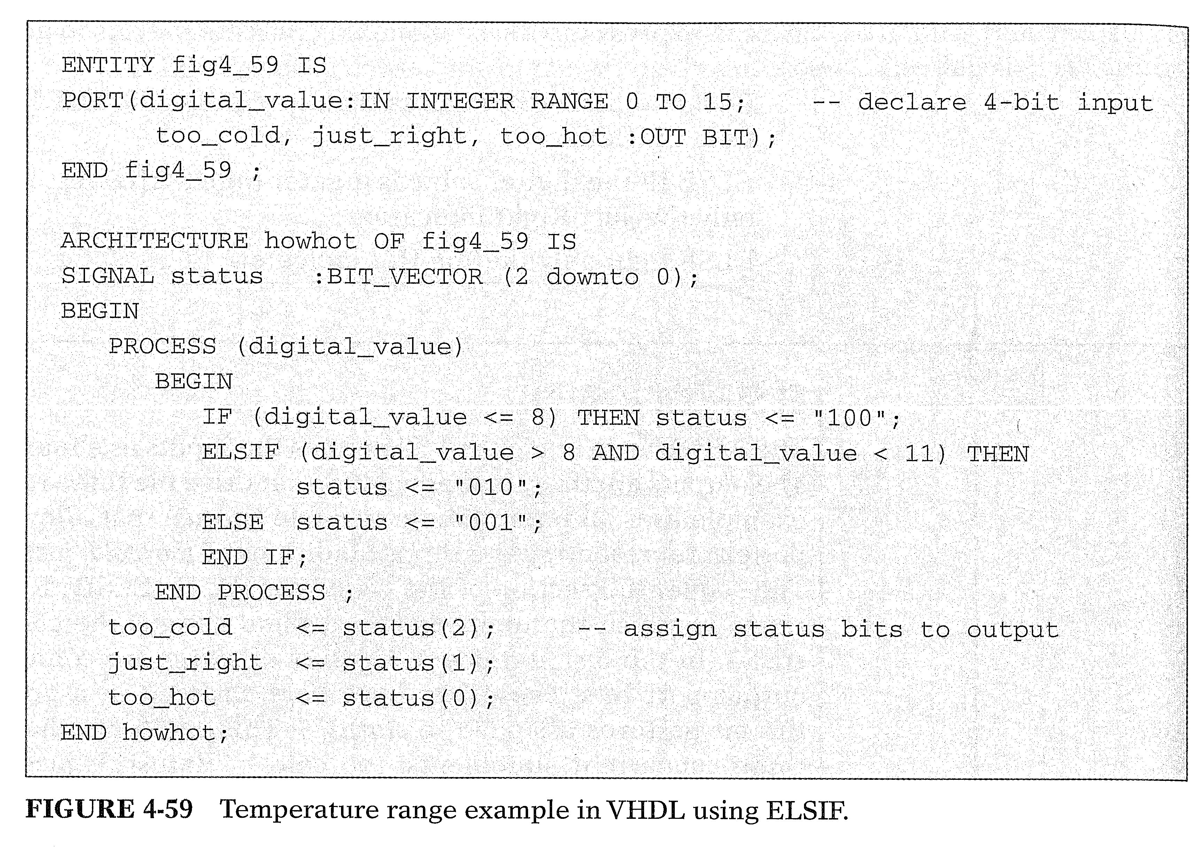
Tocci – Internal Signal, but don’t use bit, don’t use integers for input pins

Slide 16
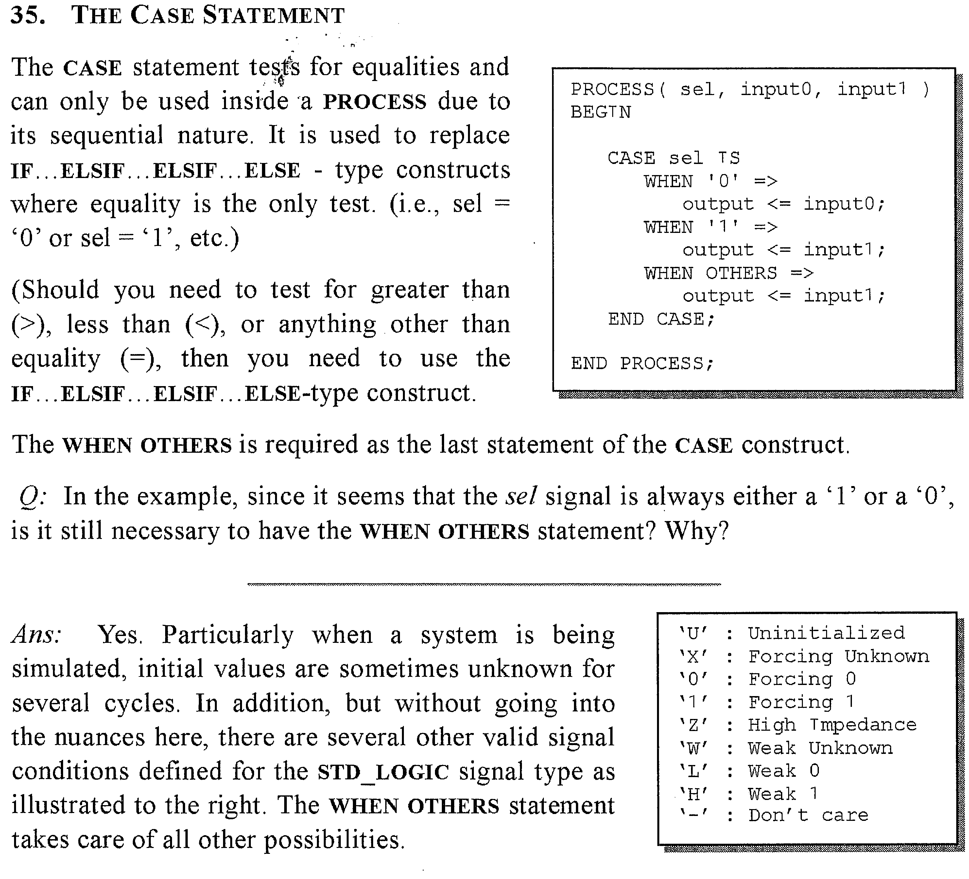

Slide 17
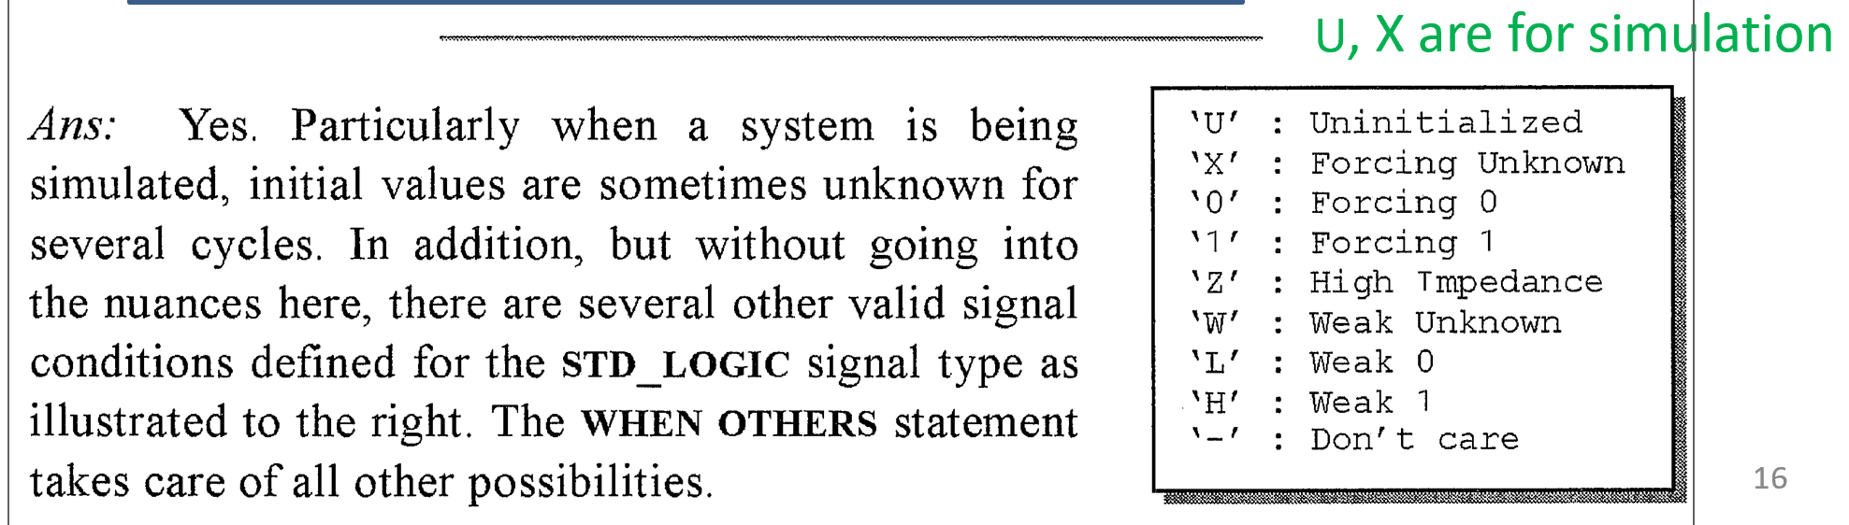

Slide 18
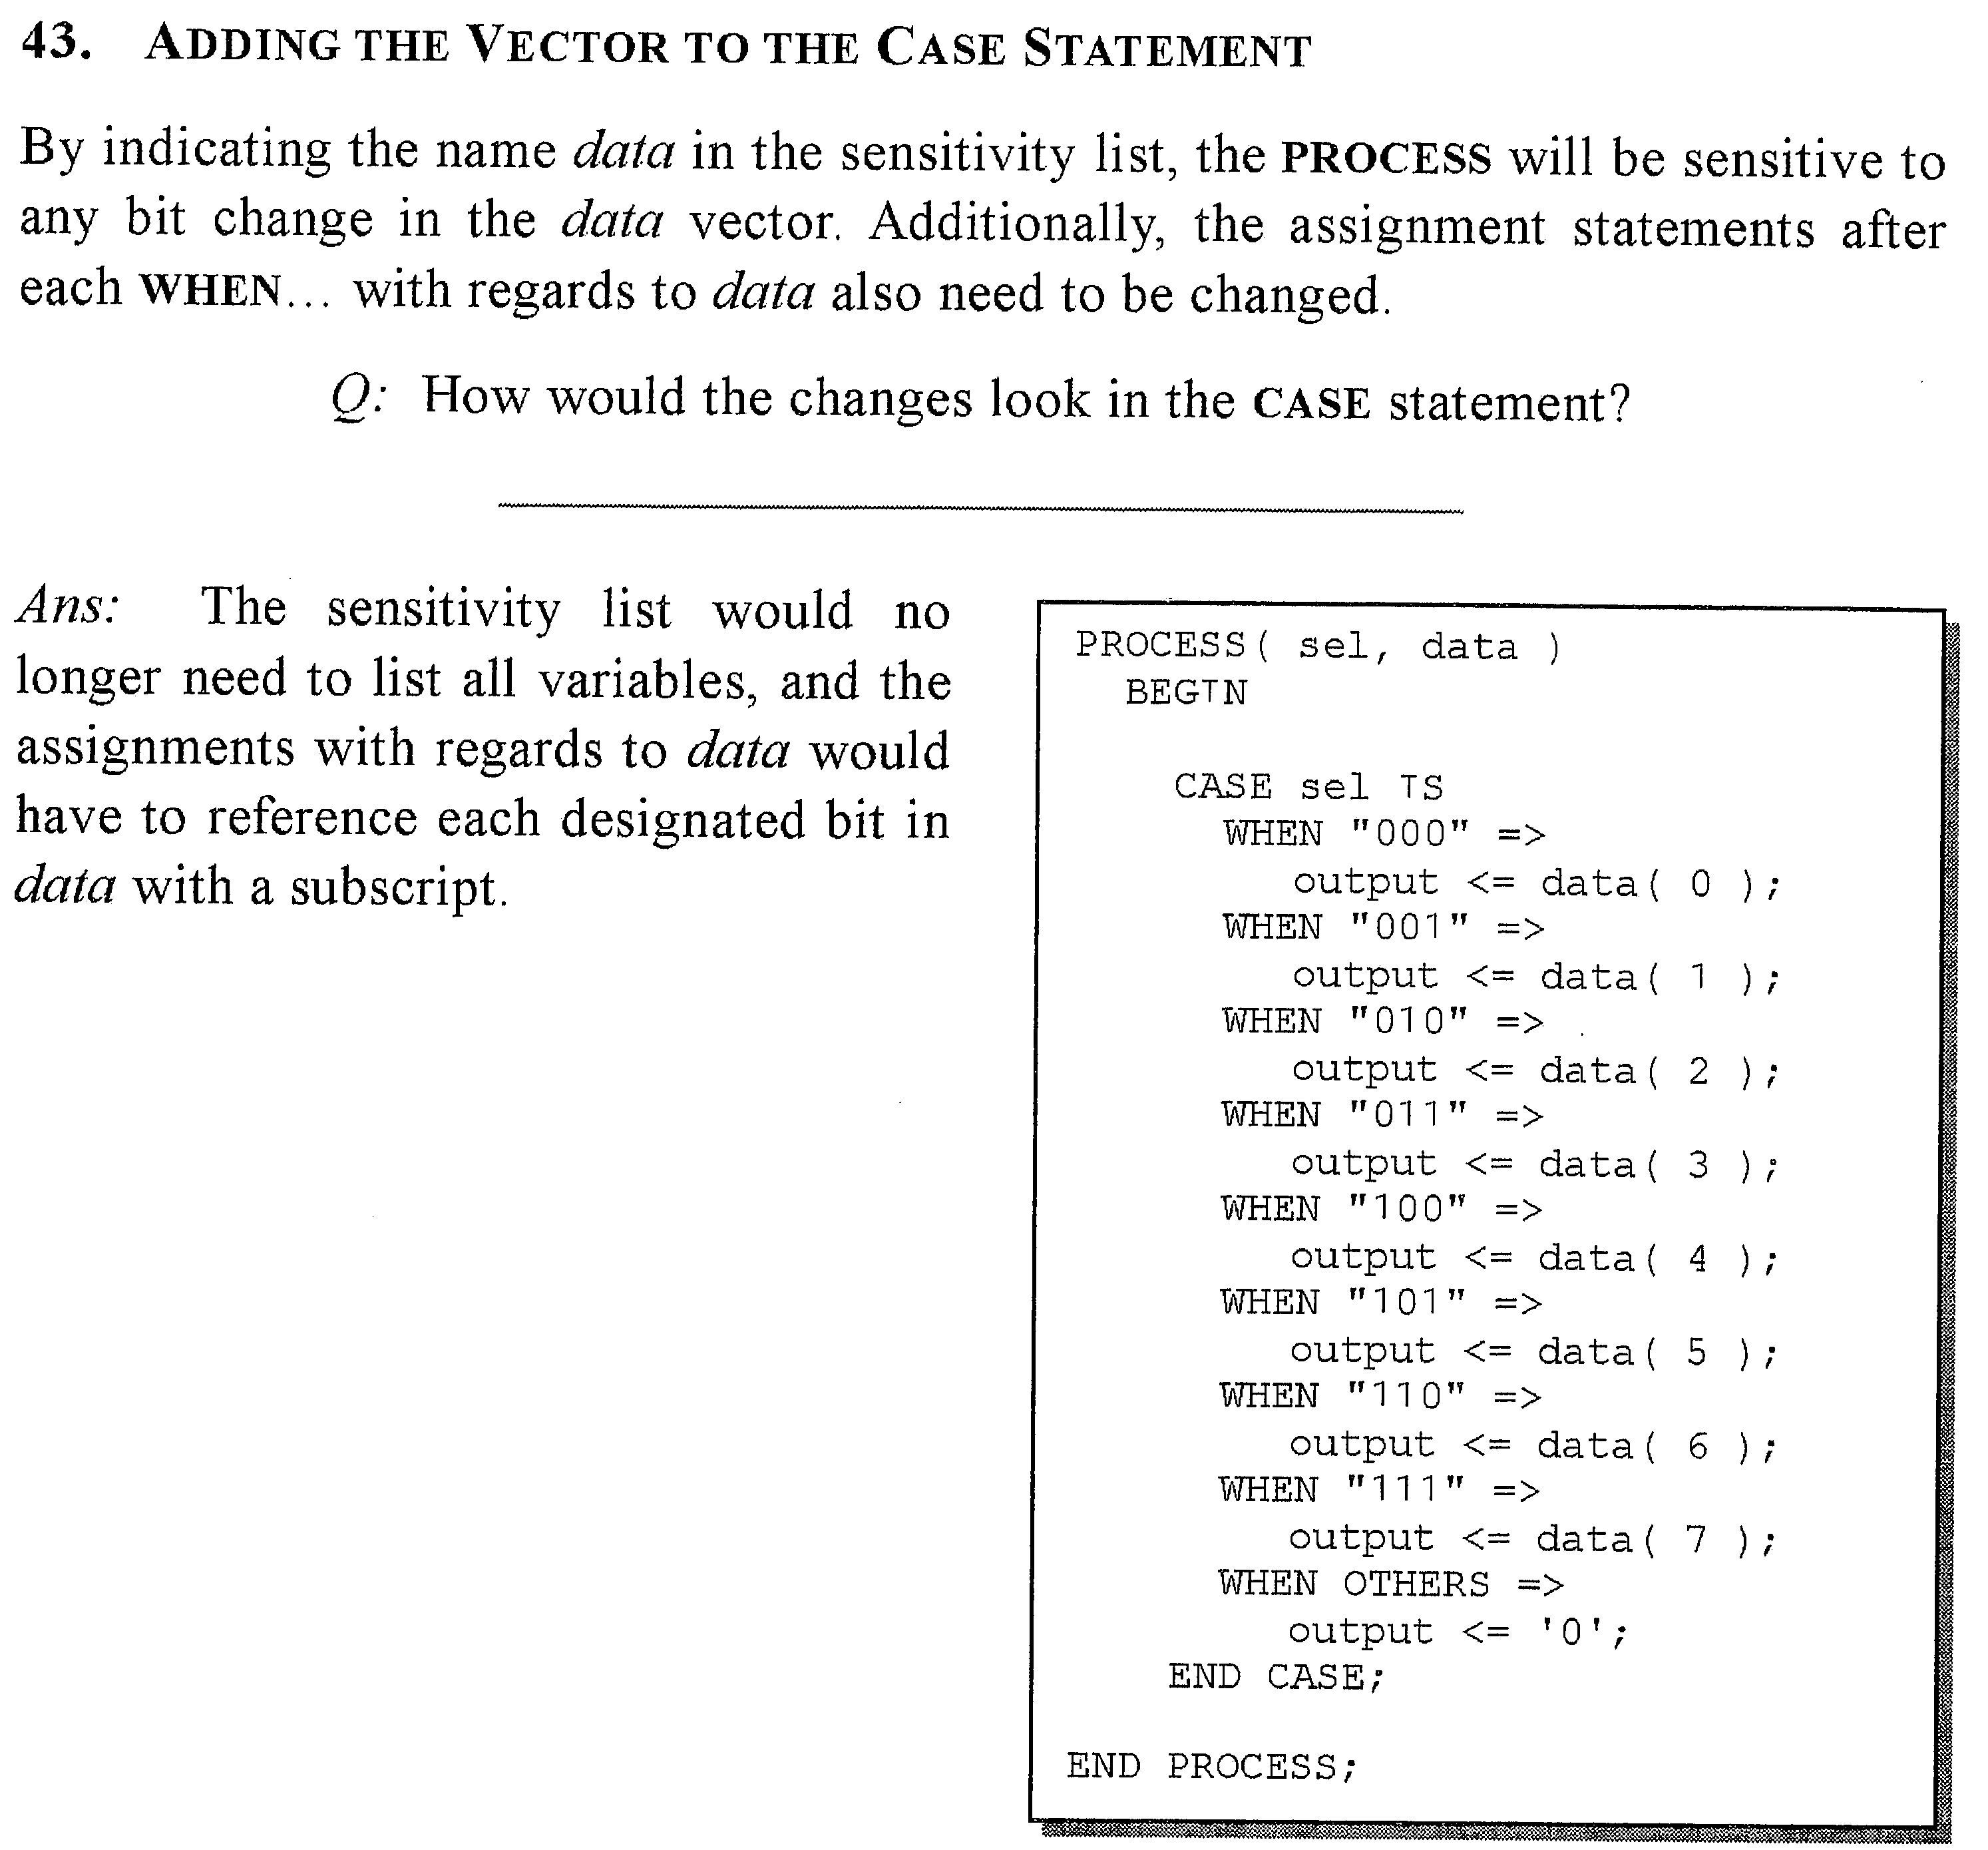











Using a

Slide 19
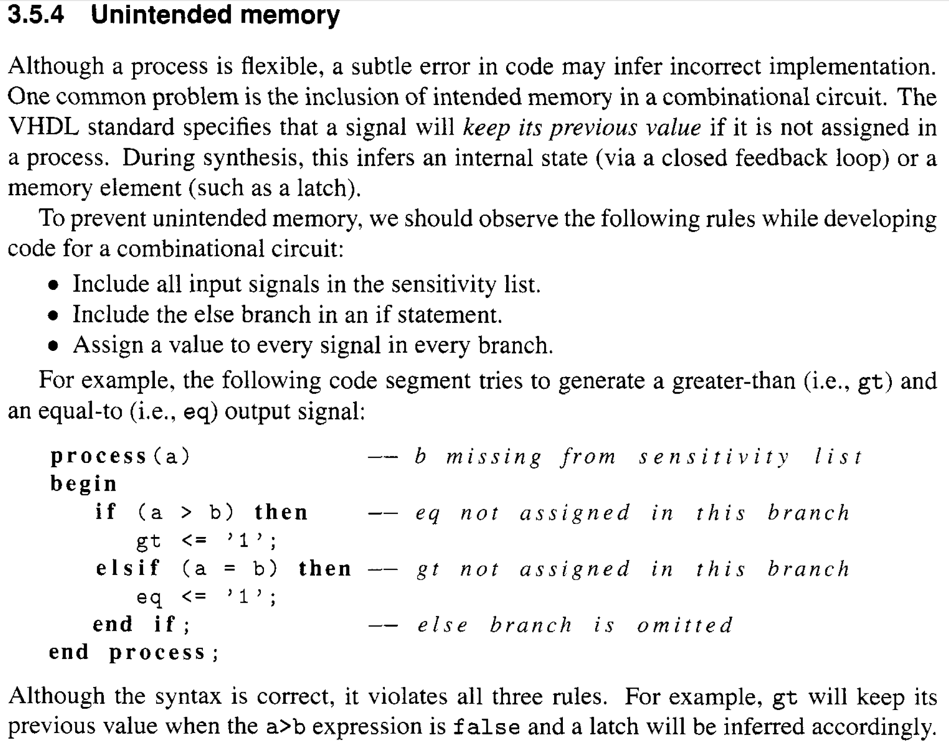




Fix this code.

Slide 20
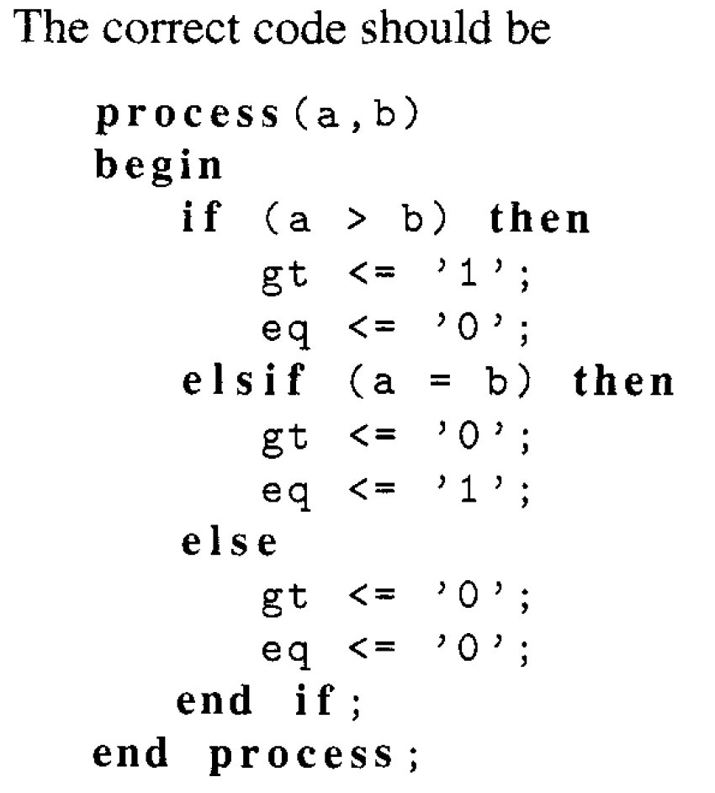

Slide 21
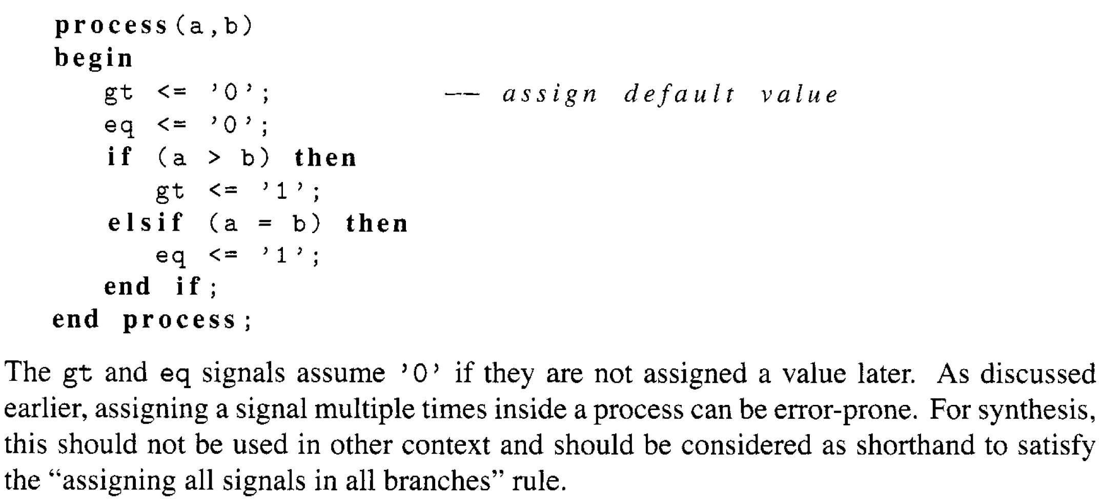


Don’t need else when using default values.

Slide 22















In std_logic combinatorial circuits,
not using ELSE and WHEN OTHERS
also generates inferred latches.

Slide 23
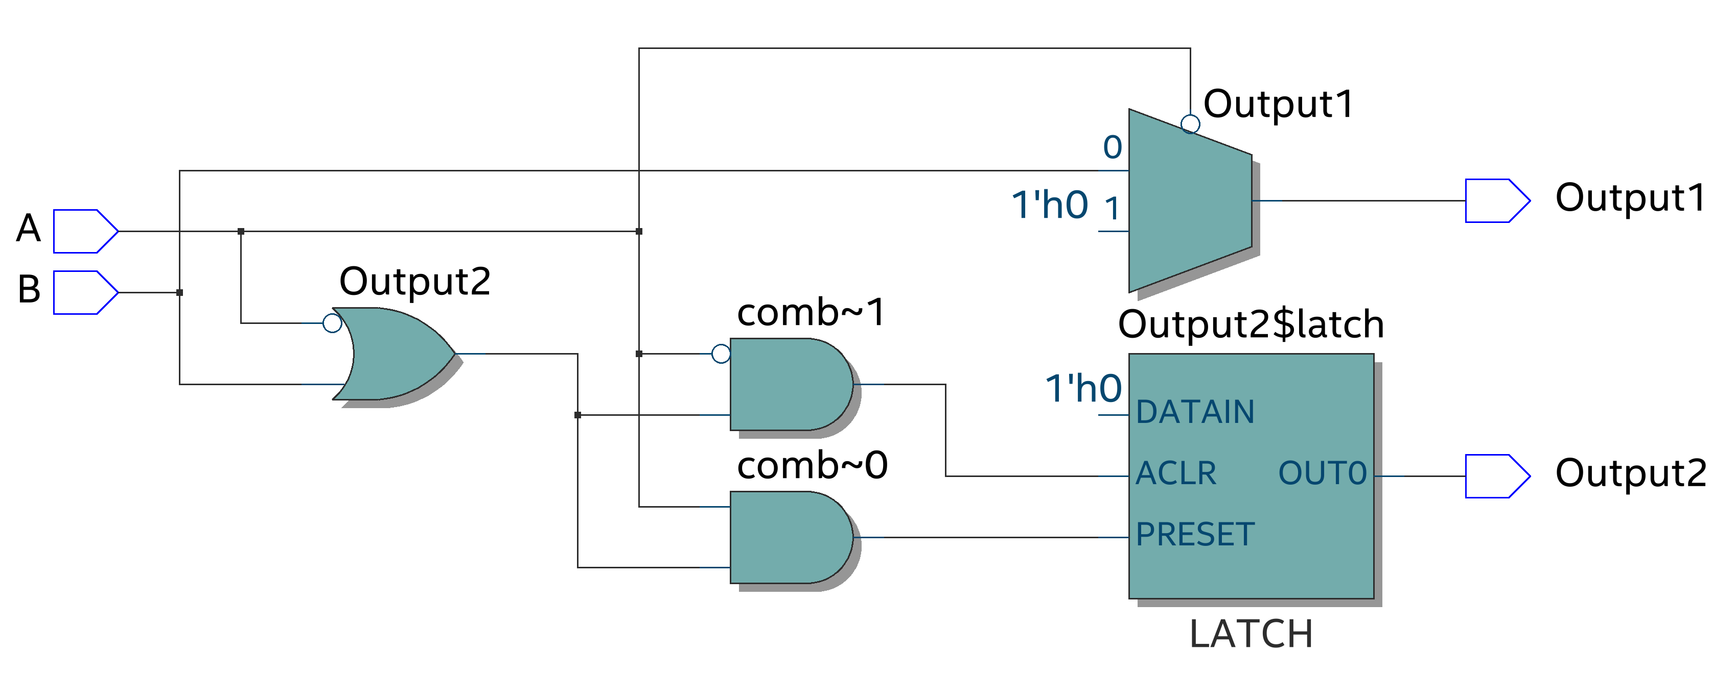
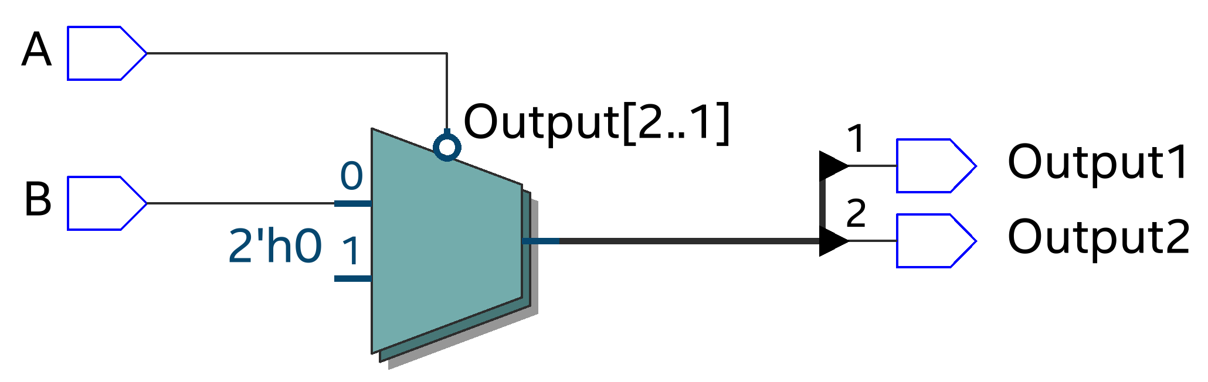
Using Quartus RTL viewer (Tools/Netlist Viewers/RTL viewer).
Output2 not specified, get inferred latch instead of MUX and extra circuitry.
With Output2 specified,
no inferred latch, just
two stacked 2:1 MUXes.
Notice the inverter on the select line.
2’h0 is Verilog notation. It means 2-bit wide hexadecimal literal with value 0, i.e., “00”.
Does the circuit operation match the vhdl code?

Slide 24
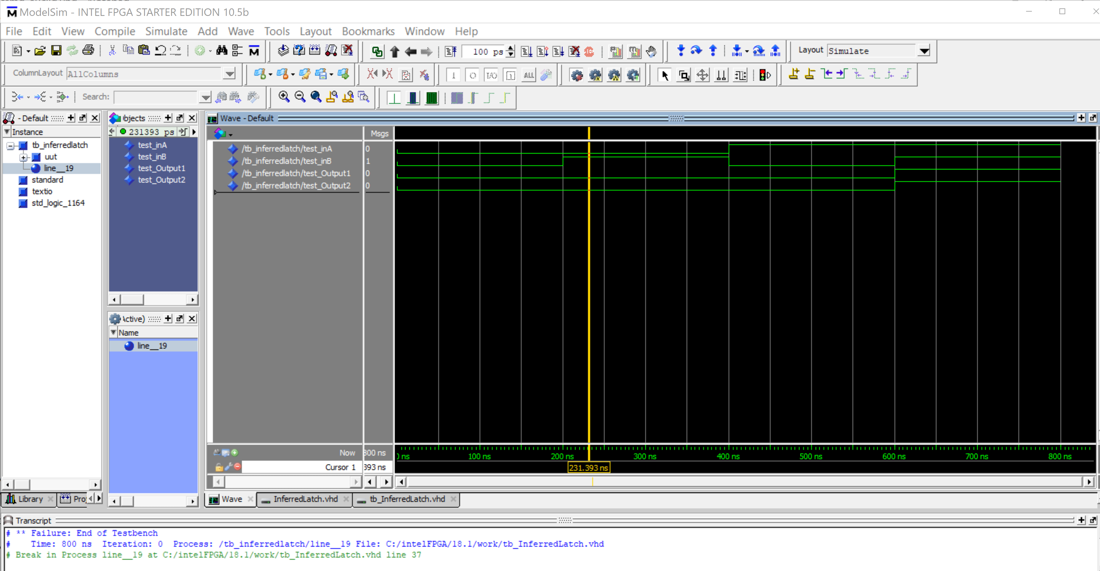
Using ModelSim testbench FUNCTIONAL simulation (not timing).
Output2 delay due to inferred latch does not show up in a FUNCTIONAL simulation.

Slide 25
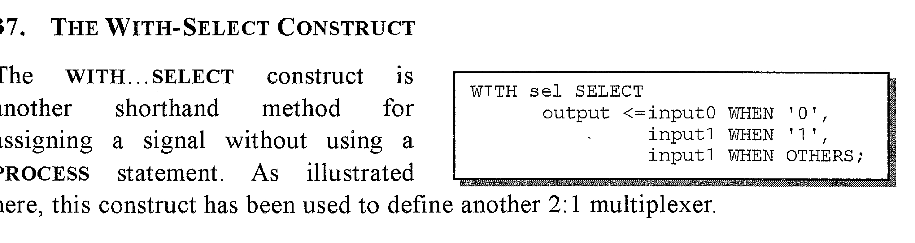


WITH-SELECT can never be used inside a process. You might be tempted to
use a WITH-SELECT as a concurrent statement nested inside an IF statement,
but this is not allowed because the IF statement has to be in a PROCESS,
and the WITH-SELECT can not.

Slide 26
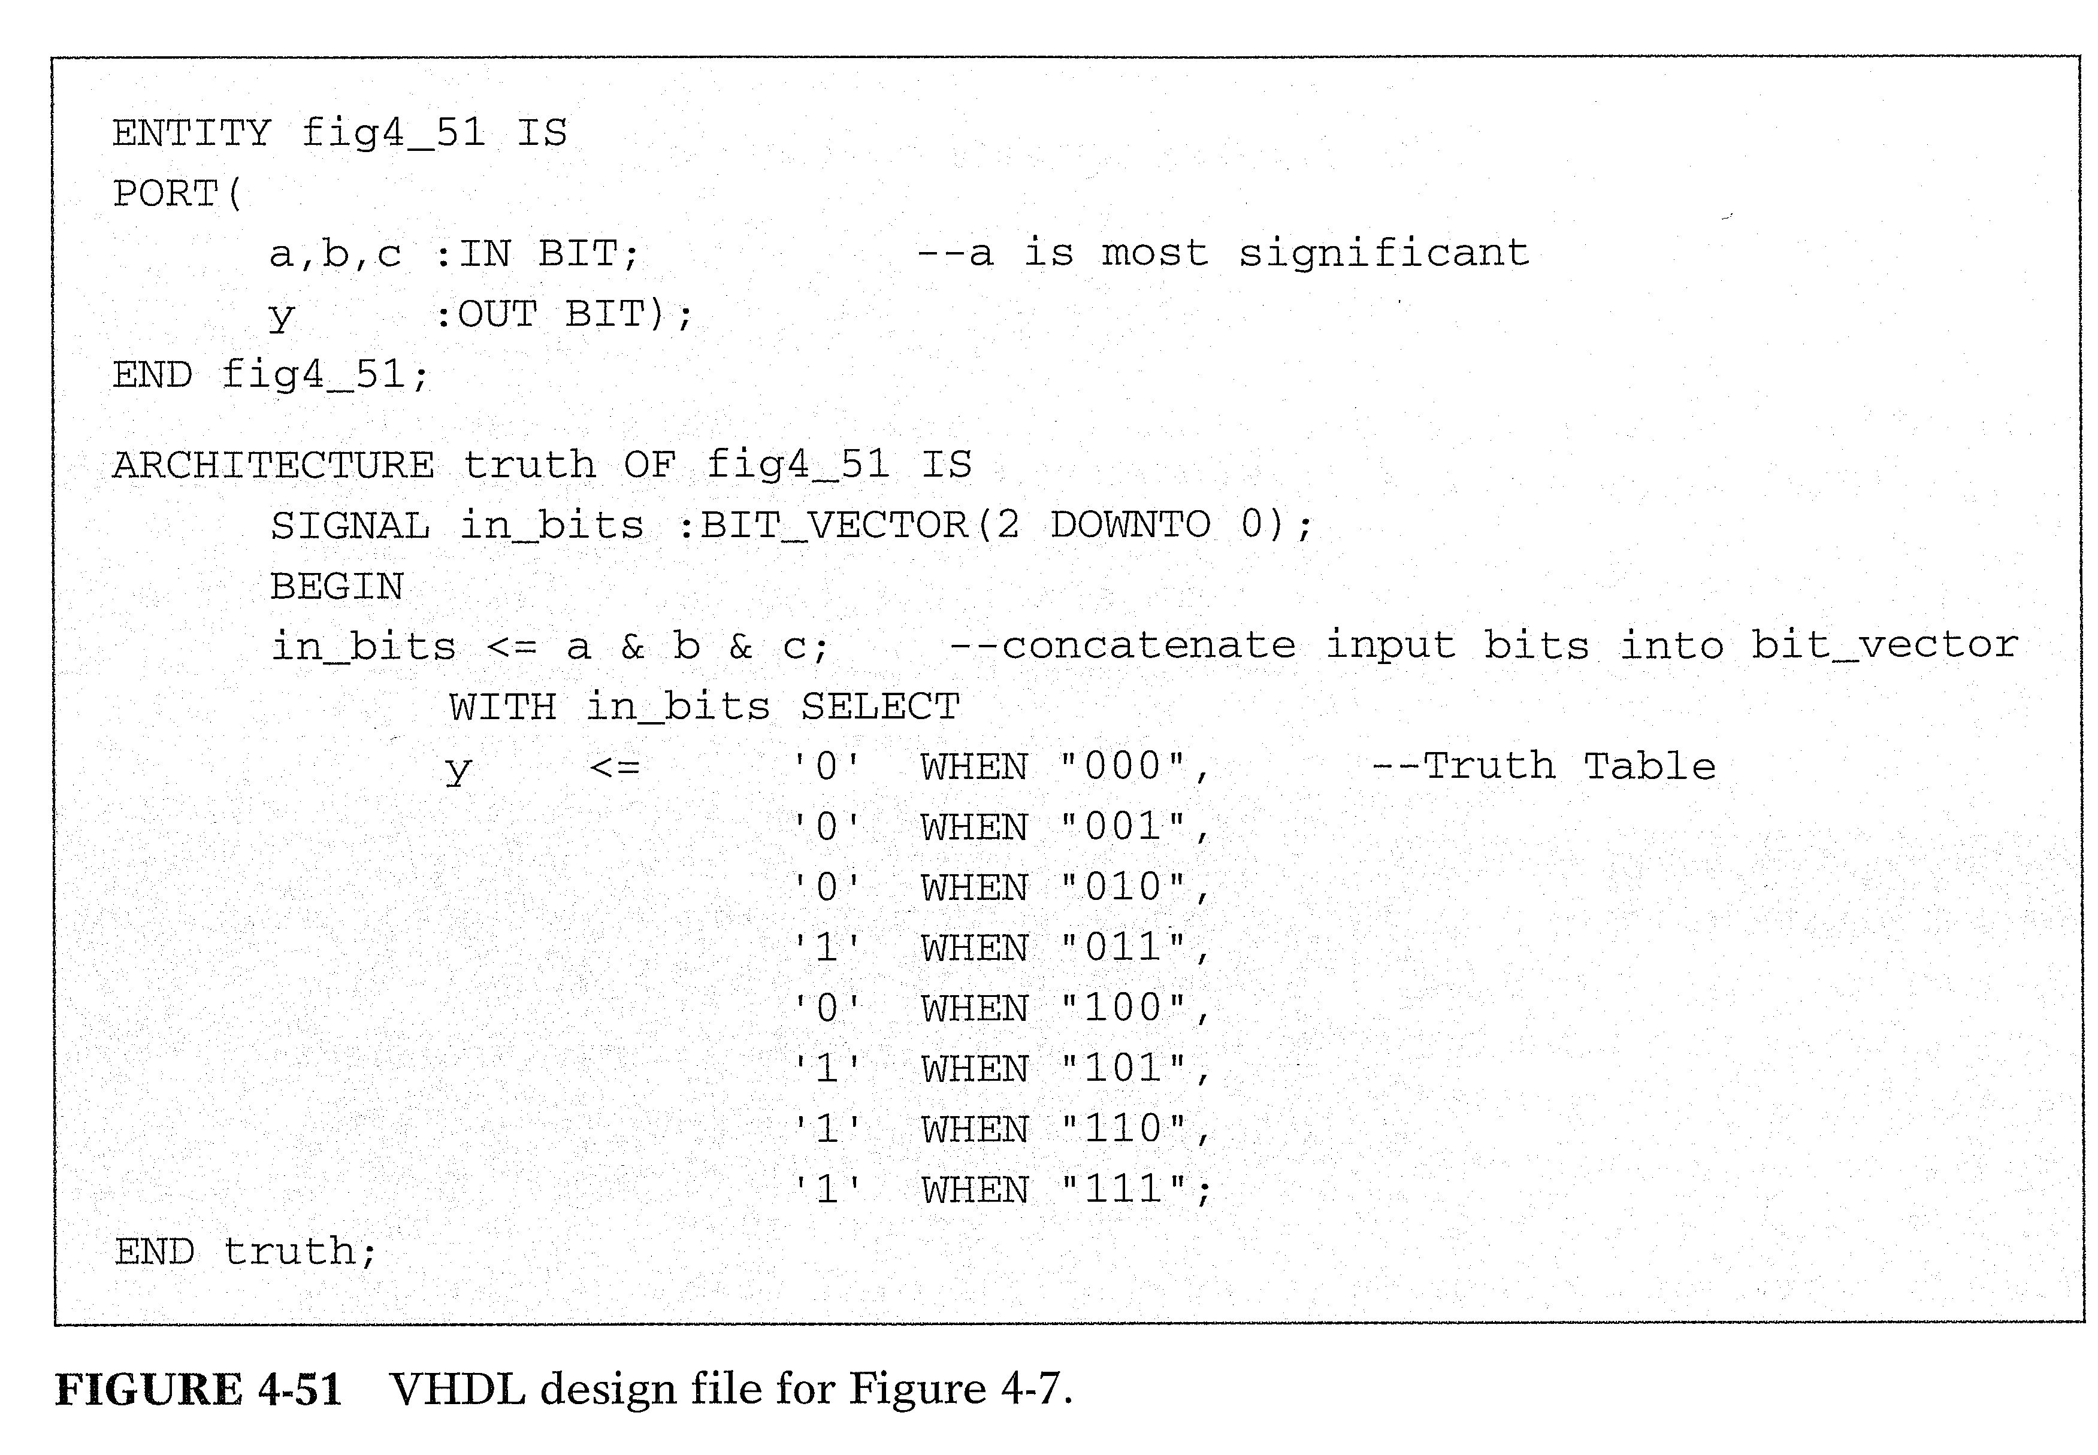






Don’t use bit, use std_logic.
Then must add WHEN OTHERS

Slide 27
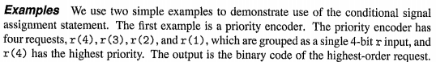
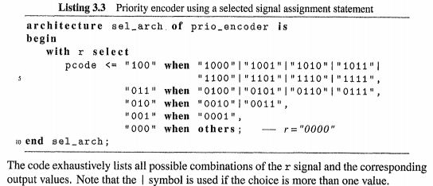

































Chu Ch. 3 p. 41 FPGA Prototyping
With-Select - illustrates putting multiple input combinations into one line of code
“ORing” choices

Slide 28
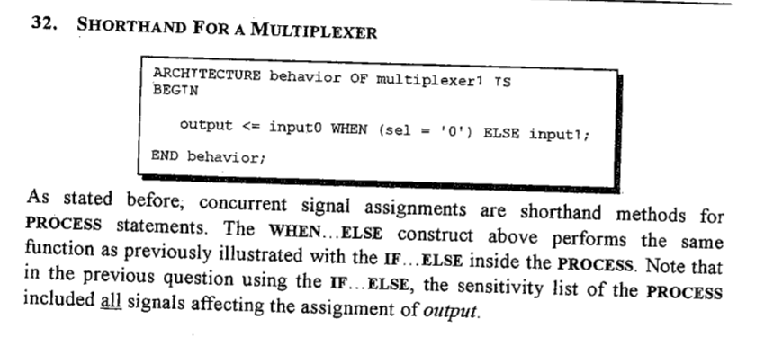


WHEN - ELSE

Slide 29
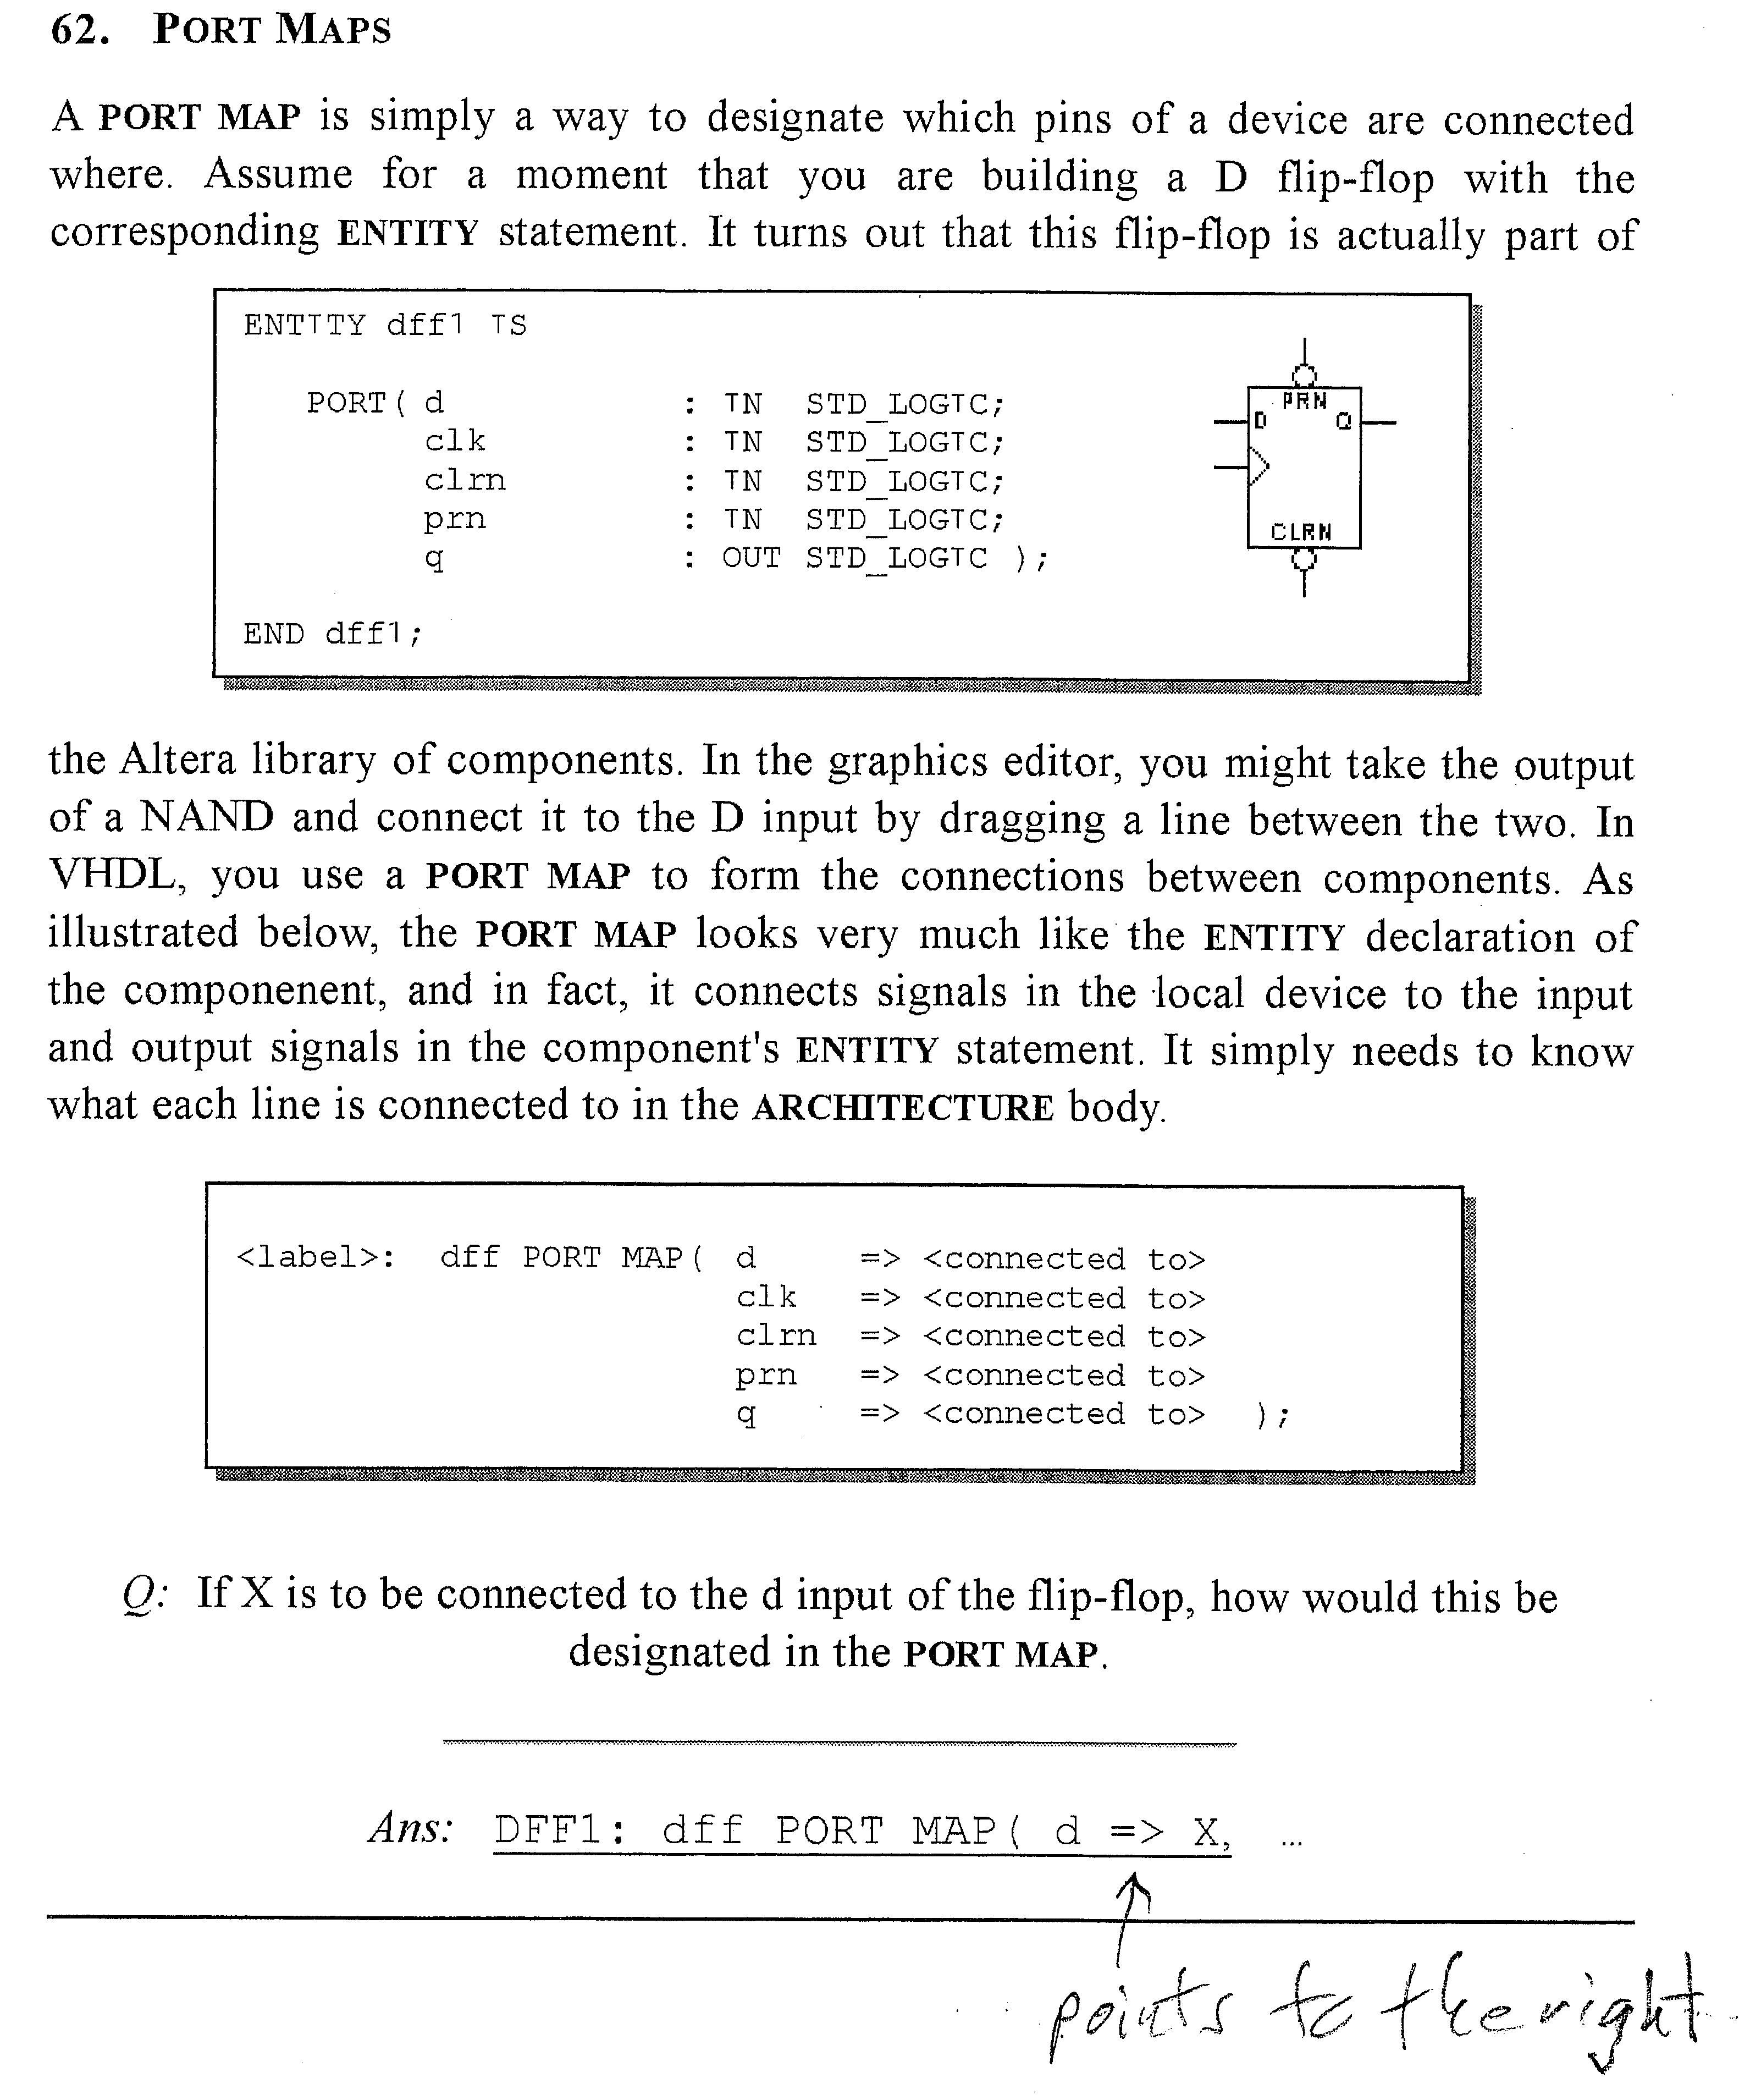





Slide 30



VHDL Heirarchy – Creating a multicomponent top-level design without schematic entry
Advantage: Does not need proprietary software that only works with Altera, etc.
Disadvantage: Sometimes hard to visualize the circuit. It is good to document it with a schematic drawing with the same signal and pin names.
The first example in the next two slides implements the circuit diagram for a state machine. It also introduces using Altera library components (a D flip flop). The Altera component library statement must be added. In addition, you have to match Altera’s component name and pin names exactly. See the Altera help file for the component you are interested in. Create a signal for each internal wire between components. A signal is not required for wires that go to pins. It is usually easier to create simple logic parts in the top-level design (the NOR gate below) instead of using their Altera component. Also note the creation of a high signal VCC.

Slide 31
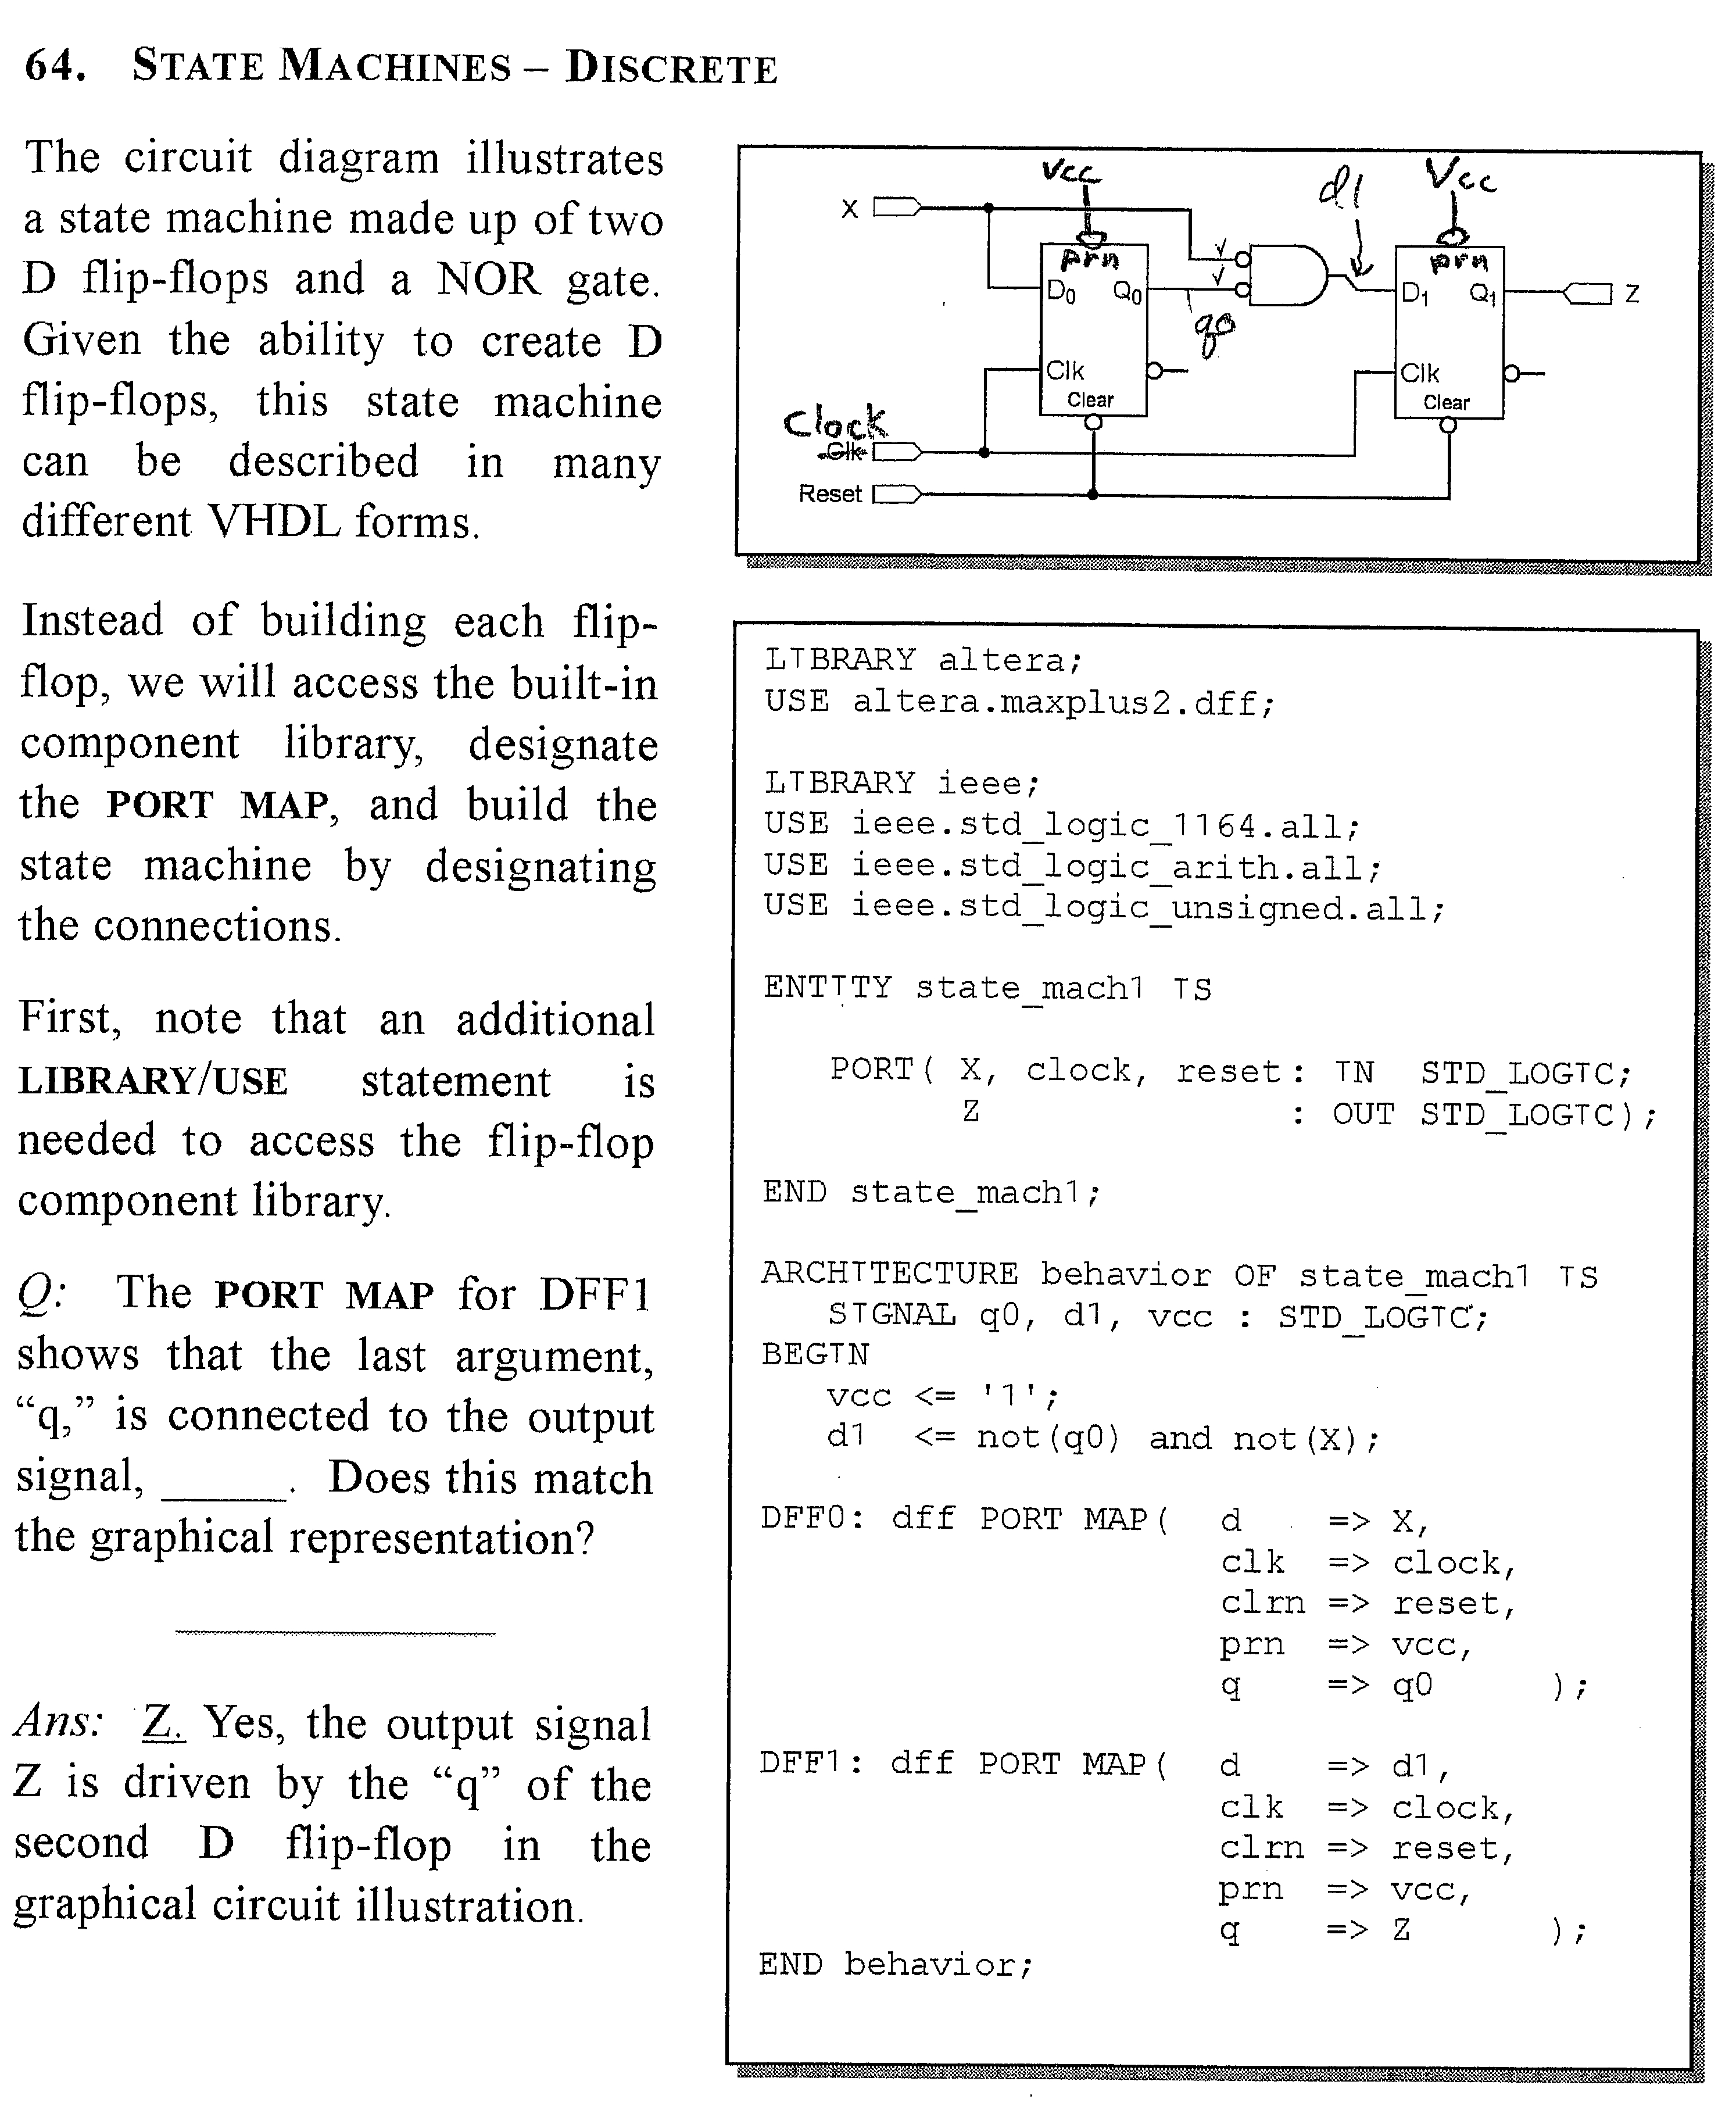






























Port Map Example –Using Altera Library FFs

Slide 32
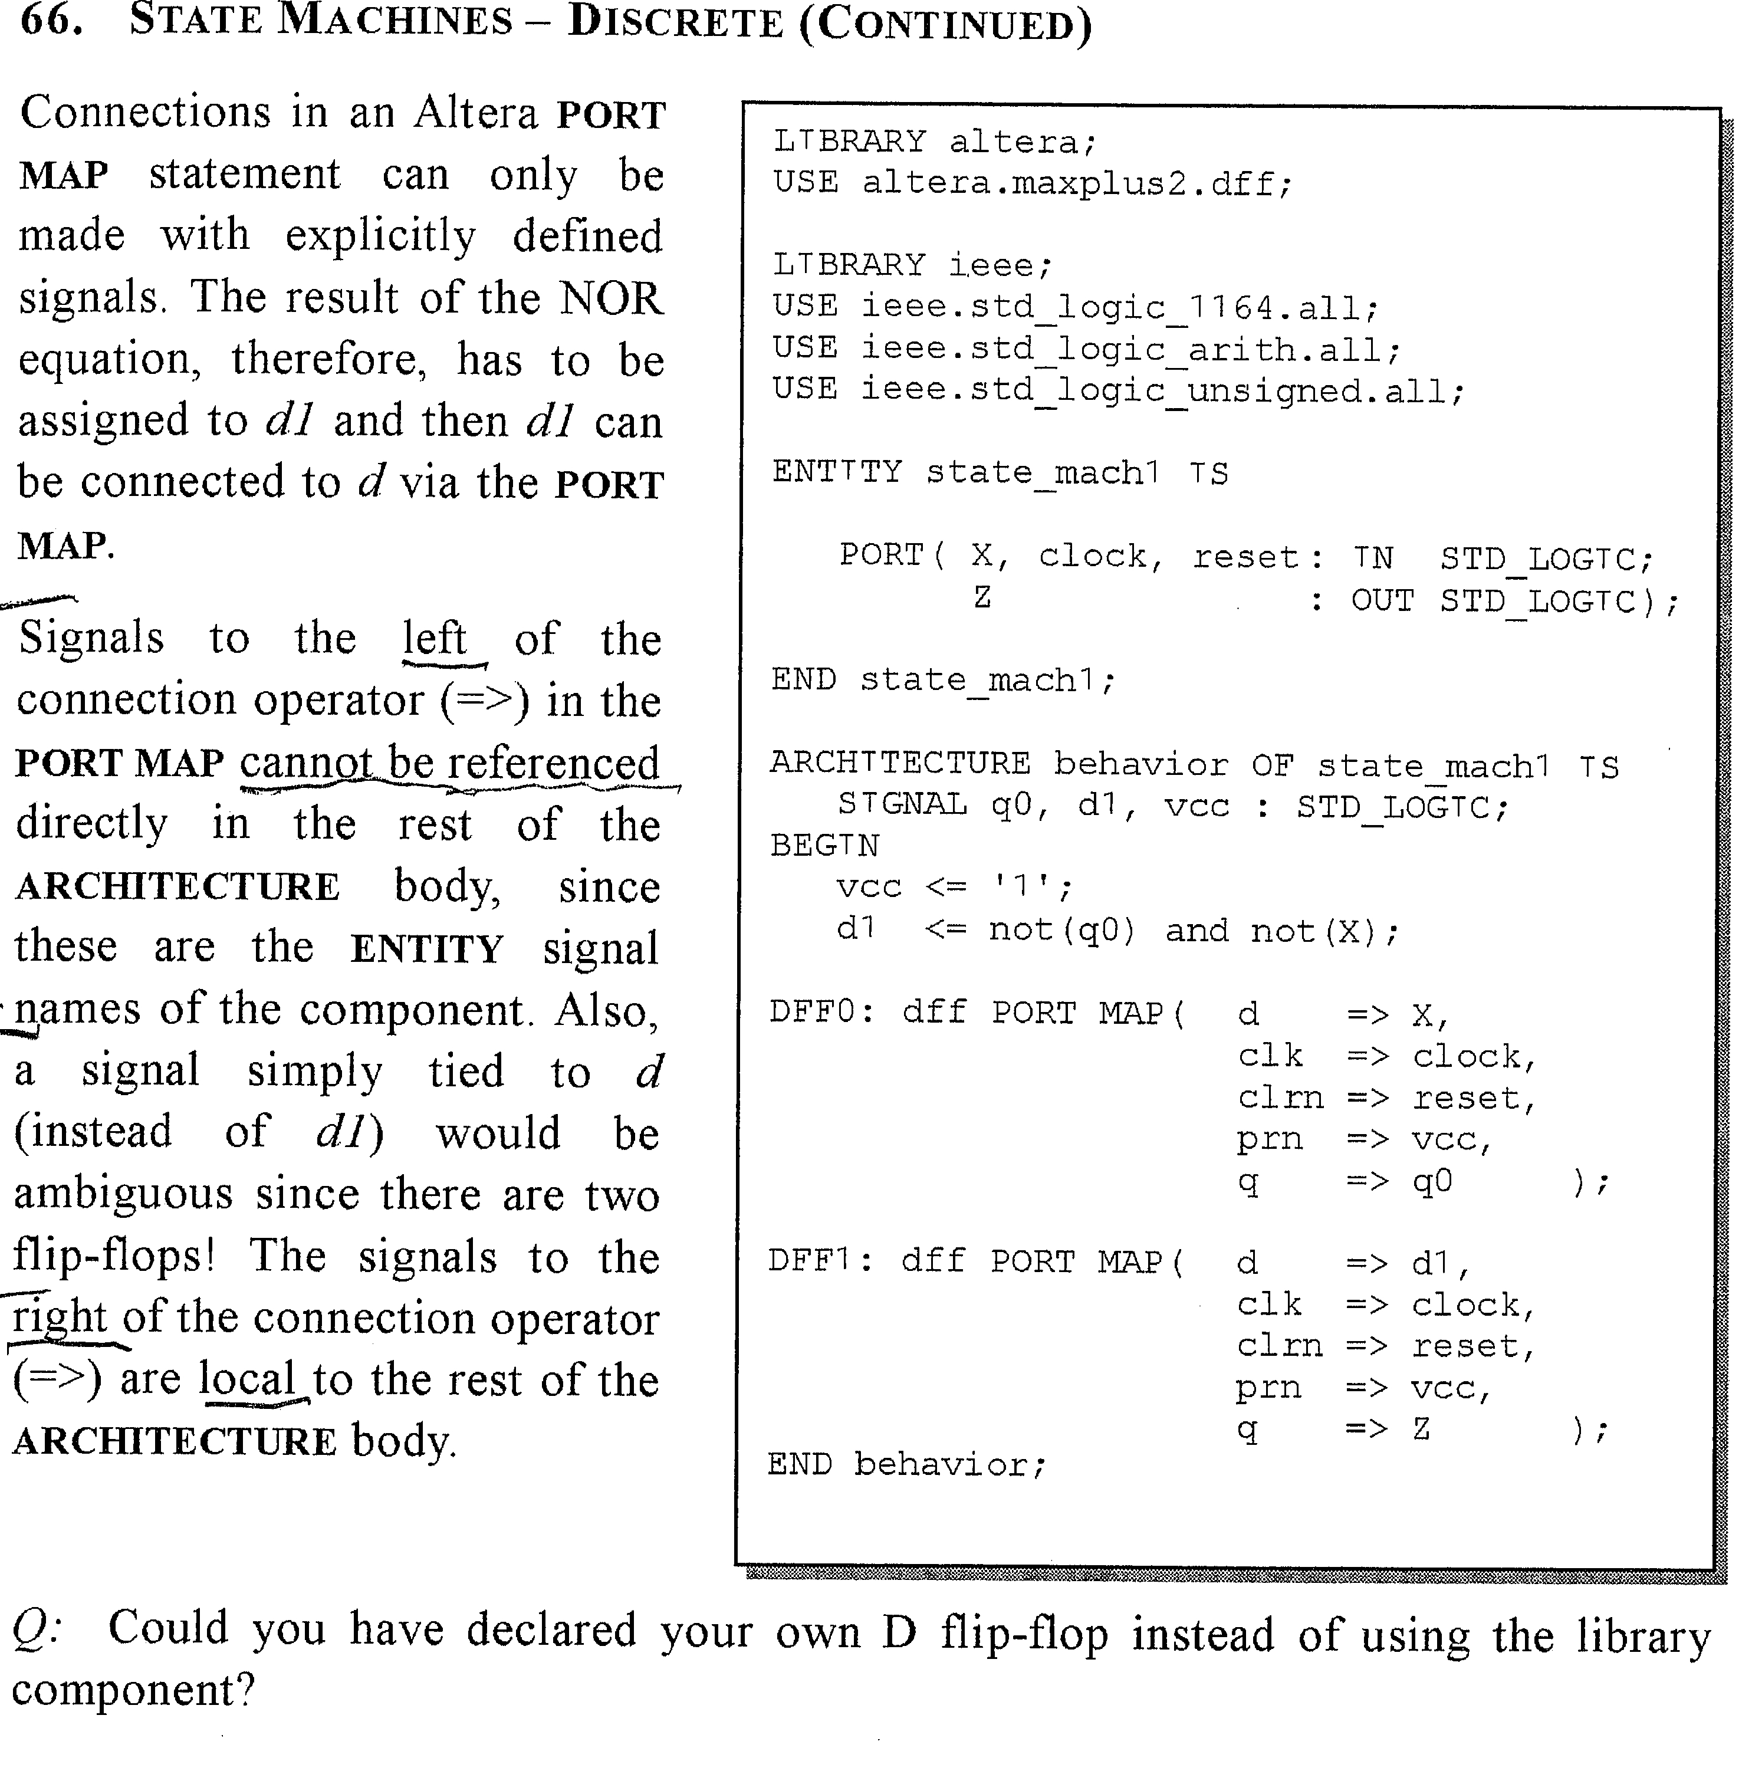





























Slide 33
The second example in the next two slides connects three components created by Georgia Tech and included with their Rapid Prototyping SOPC edition lab book . It shows how to add the component definitions using the old way (VHDL-87 standard) which is required when the component is not in the Altera library. Note that the definitions inside each component are the same as the port map for the component entity. Some designs use more than one “instance” of the component. Therefore you must make up a unique name for each instance. Notice how the use of informative signal names is important (I find their using the same name as the component pin confusing) when writing the port statements at the end of the file. But there also is usually a need for documentation with a schematic.

Slide 34
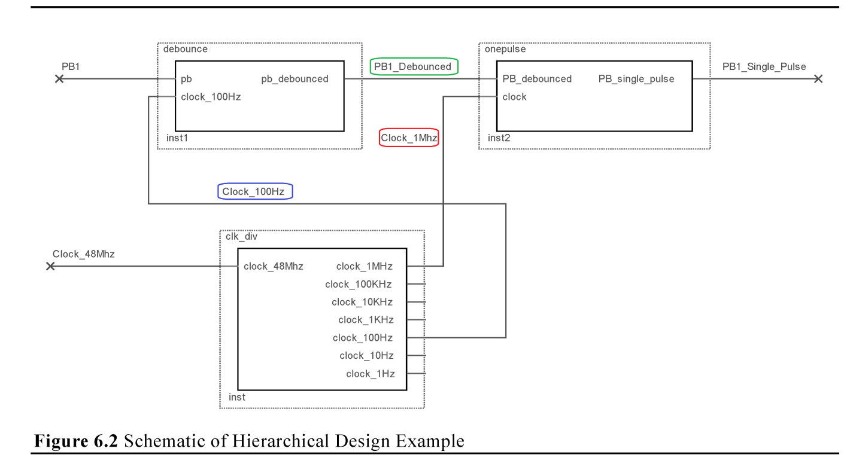
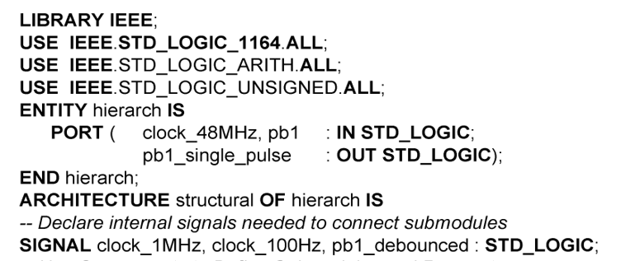






Using old VHDL-87 component declarations.
How to convert schematic to VHDL code
1) Port Statement for external PINS
2) Make each INTERNAL wire a signal.

Slide 35
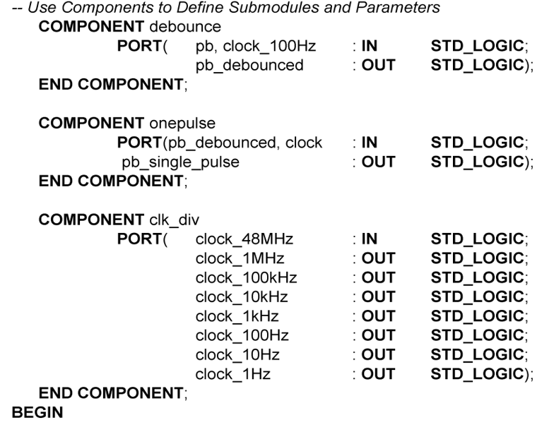






3) Declare components (copy port statements)
debounce
onepulse
clk_div

Slide 36
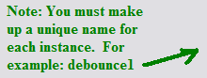
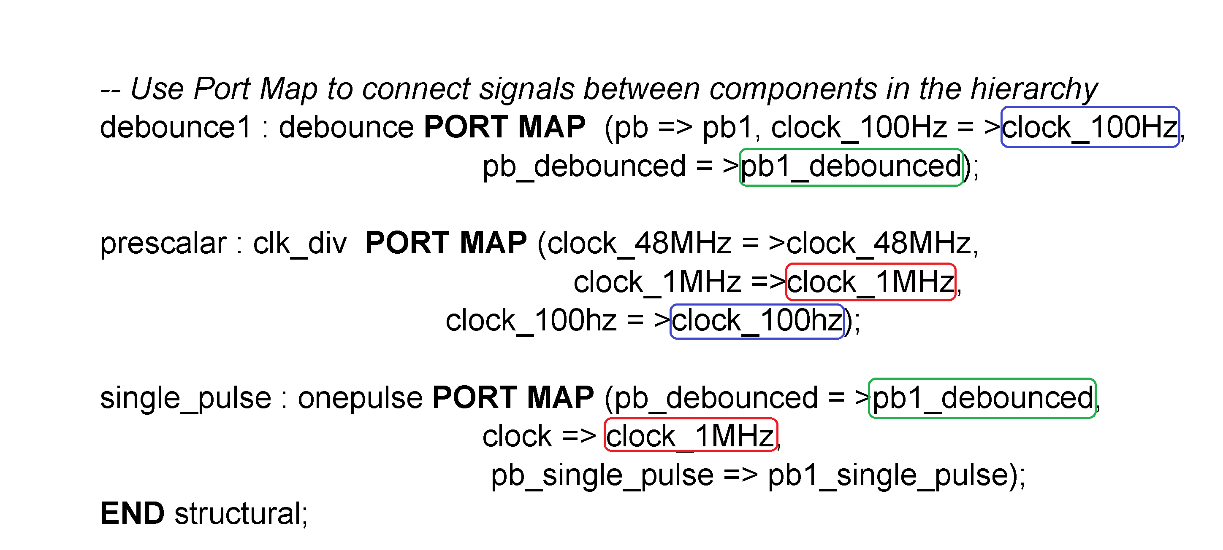


4) Connect components

Slide 37


The third example in the next three slides connects two components (1-bit comparators) to make a 2-bit comparator. It shows how to add the component definitions using the new way (VHDL-93 standard) which is required when the component is not in the Altera library. Some designs use more than one “instance” of the component. Therefore you must make up a unique name for each instance, the same as for the old way. However, instead of using the COMPONENT keyword and copying the port map, you tell the VHDL compiler where the component is stored, by using the ENTITY keyword followed by which library holds the component. The components are usually in the default library, which is named WORK.
The 4th slide shows how to implement the 1-bit comparator component the old way (VHDL-87).

Slide 38
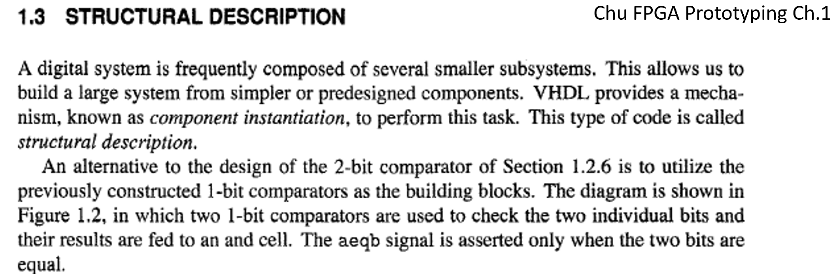
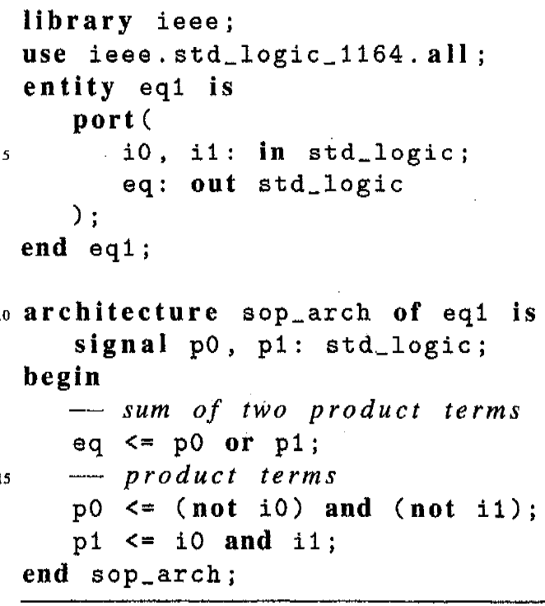
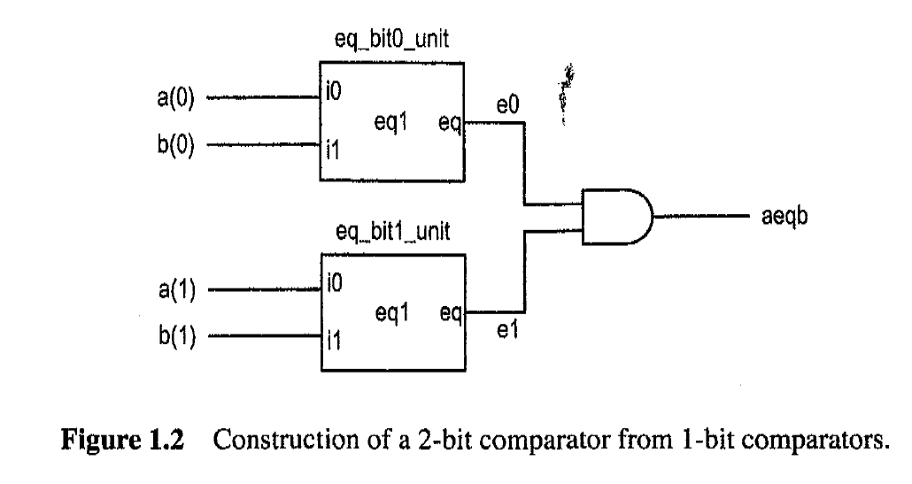







1-bit equality comparator eq1 (sum of products from truth table)

Slide 39
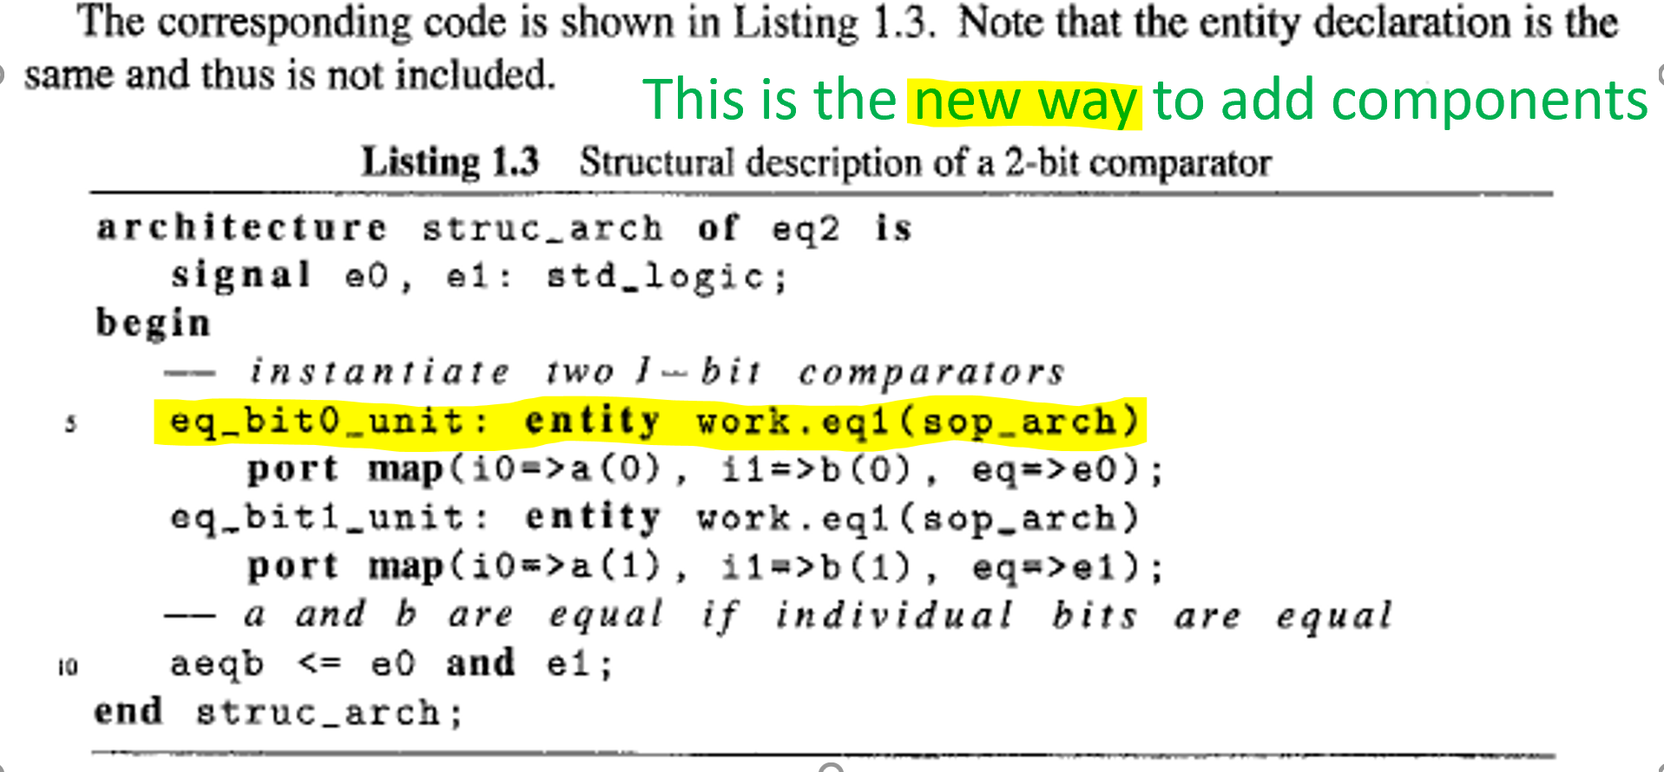

Slide 40
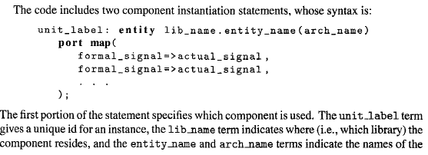
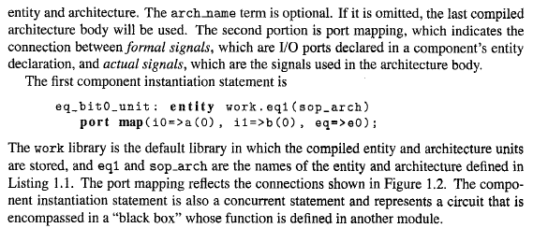














Slide 41
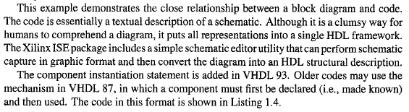
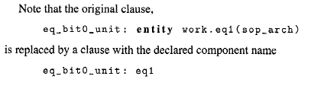








However, the port map statements are the same in both ways.

Slide 42
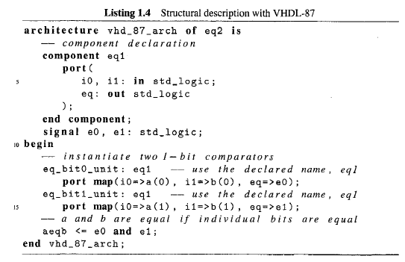

using the old VHDL-87 way.

Slide 43
Handling Unused Signals with Port Maps
Reference www.NandLand.com “Dealing with unused signals in VHDL”
A signal that you created that is not used in your design:
Quartus will generate a warning and not implement it.
2. Instantiating a component with an input signal that is not used:
for STD_LOGIC, connect it to ‘0’
for STD_LOGIC_VECTOR, connect them to (OTHERS => ‘0’).
Note that OTHERS => ‘0’ is shorthand for “00000000…”,
and you don’t have to know ahead of time how many of bits there are.
3. Instantiating a component with an output signal that is not used:
Connect it to OPEN.

Slide 44
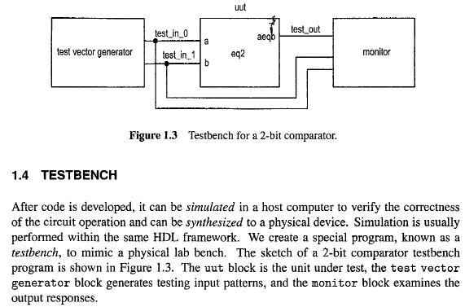











for combinatorial circuits
(see the sequential vhdl ppt for that testbench)

Slide 45
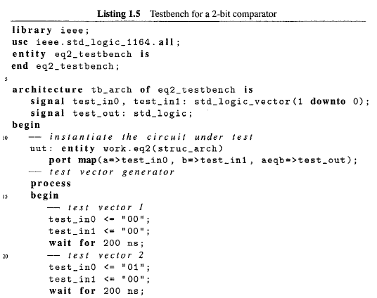















and connect test signals
0
0

Slide 46
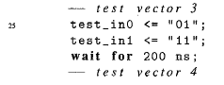
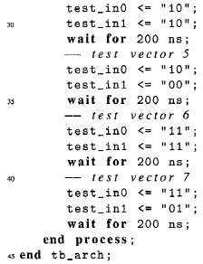

All combinations of inputs should be
tested whenever possible (16 in this
case). However, in real-world applications,
it is often not feasible. Problems often
show up after the circuit is in actual use.
assert false
report "Simulation Completed“
severity FAILURE;

Slide 47
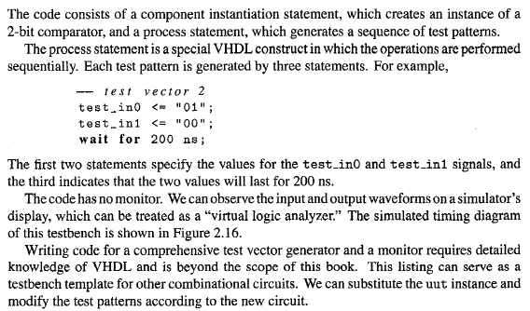



Slide 48
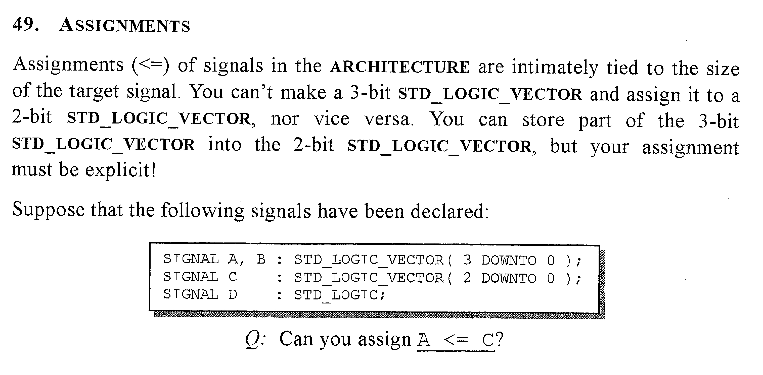

Slide 49
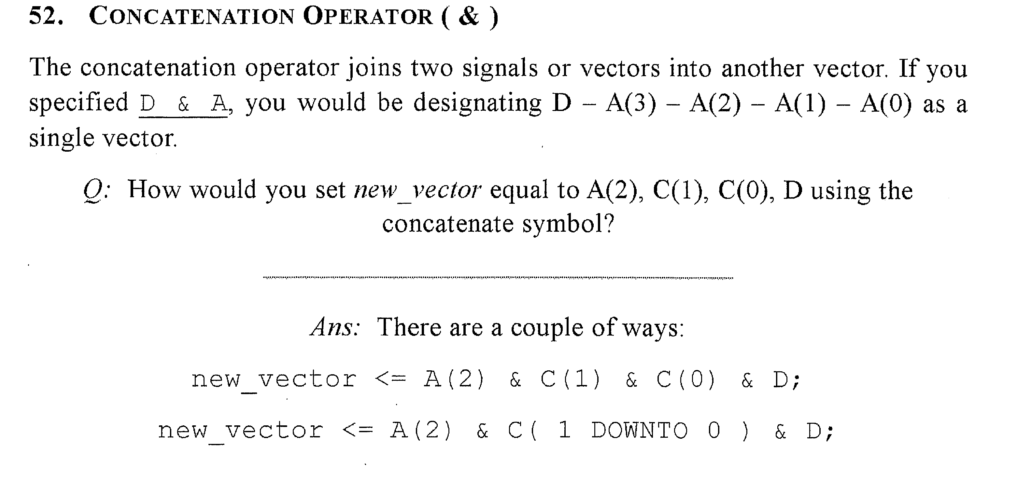

Slide 50








Concatenating input bits into a vector
Don’t use bit, use std_logic.

Slide 51
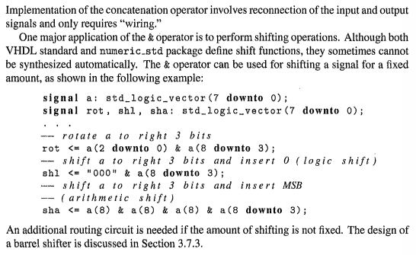














Shift register using concatenation of vectors Chu Ch. 3 p. 39 FPGA Prototyping
2’s complement stays correct even when negative

Slide 52





Slide 53









Slide 54










Integer data type - positive and negative integers (and zero)
Natural data type - positive integers and zero.
Signed uses two’s – complement. Use with integers.
Use unsigned with natural.

Slide 55









Slide 56













Slide 57







Use 4 bits
Use 4 bits

Slide 58








Slide 59






Slide 60










Chu Ch. 3 p. 39 FPGA Prototyping

Slide 61



























Slide 62





Slide 63




Chu Ch. 3 p. 53 FPGA Prototyping

Slide 64









-- extend vector by 1 bit

Slide 65











Slide 66







Chu Ch. 3 p. 54 FPGA Prototyping
generic allows changing number of pins and also signal lines in the current design
as well as when the design is used as a component (generic mapping)

Slide 67











generic allows changing number of pins
generic also allows changing number of signal lines
generic also allows changing number of signal lines

Slide 68












